Slide 1
Module 3: Ensuring Specimen Integrity for Viral Load Testing
DRAFT
Suitable for all cadres: Clinicians, Counselors, Phlebotomists, and Laboratorians

Slide 2

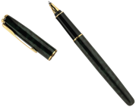
Module 3: Learning Objectives
List the specimens rejection criteria for viral load testing
Describe the correct specimen collection procedures for viral load testing
Perform correct procedures for separation of plasma from whole blood
Properly prepare dried blood spots (DBS) for viral load testing*
Properly store and package specimens for transport
Track specimen referral status to ensure timely return of all test results
*laboratory session

Slide 3
The Quality of Specimens Affects Viral Load Test Results
Pre-testing Phase
Specimen collection and processing
Specimen storage and packaging
Specimen transport
Specimen receipt
Specimen check-in
Specimen collection sites and hubs
Testing sites
Reject or accept Specimen
To ensure integrity of the specimens, you need to:
Properly collect and process specimens
Properly store and package specimens for transport
Ensure timely pickup and proper delivery of specimens by couriers
Track specimen referral status to ensure timely return of all test results

Slide 4

Keep Your Turn Around Time Short
Turn Around Time =
TAT 1 + TAT 2 + TAT 3 + TAT 4 + TAT 5
TAT 1
TAT 2
TAT 3
TAT 4
TAT 5
From sample collection to sample pickup for transport
From sample pickup to sample delivery to testing laboratory
From time sample received at lab to result released to the clinic
  From receipt of results by clinic to return of results to clinician
  From receipt of results by clinician to return of results to patient for management of care
Wait time for sample pickup
Sample transport
Time spent inside testing lab
From clinic to clinician
From clinician to patient

Slide 5
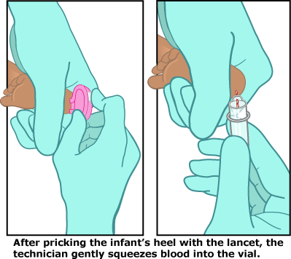
Methods for Blood Collection
Venipuncture
Finger Prick
X
Heel Stick

Slide 6
Specimens Used for Viral Load: Plasma and Dried Blood Spots (DBS)
Collection Method
Sample Processing
Gold standard for viral load testing
Plasma
Venipuncture Whole Blood
DBS
Finger Prick Whole Blood

Slide 7
Plasma vs. DBS for Viral Load Testing:
Pros and Cons
Plasma | DBS
Pros: Gold standard for testing with years of data to back up utility of this specimen Can be tested on any platform Best able to give a measurement of the amount of free virus circulating in the blood Less processing time during testing phase Stability of sample during long term storage is good when kept at correct temperature Cons: Requires a centrifuge for sample processing Requires cold chain transport Requires a -70C freezer for long-term storage | Pros: Does not require cold chain transport Can be stored at room temperature for at least two weeks with proper packaging Less sample volume required Cons: Limited data from ART patients on suitability of DBS for detecting viral failure Requires proper packaging and reduced humidity for stability More sample processing time prior to loading onto testing platform Not all platforms are suitable for DBS Cellular DNA and cell associated RNA contribution

Slide 8
Knowledge Check
Which of the following specimen type is the gold standard for viral load testing?
  Whole blood
  DBS from finger prick
  DBS from venipuncture
  Plasma from finger prick
  Plasma from venipuncture
√

Slide 9
Specimen Collection and Processing

Slide 10
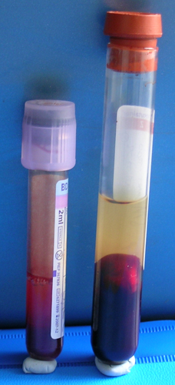
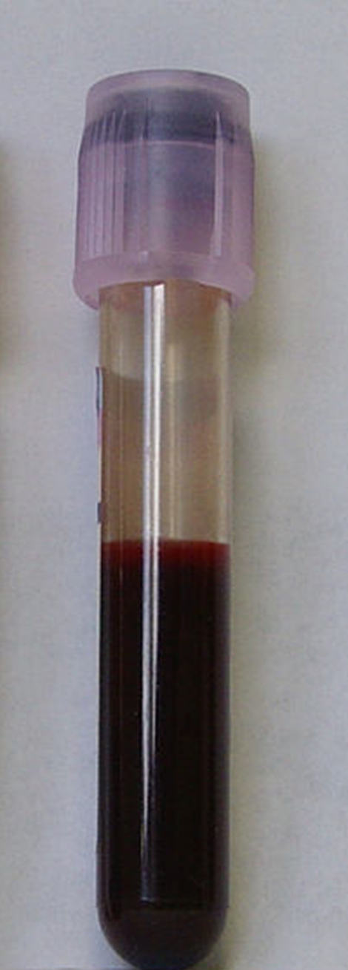
Example of Valid and Invalid Venous Blood Specimens
Valid whole blood
Clotted
Hemolyzed

Slide 11
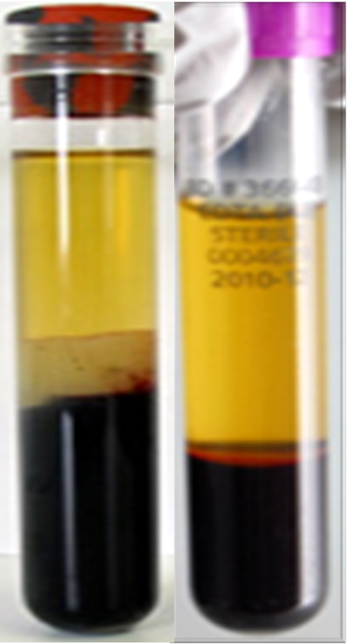
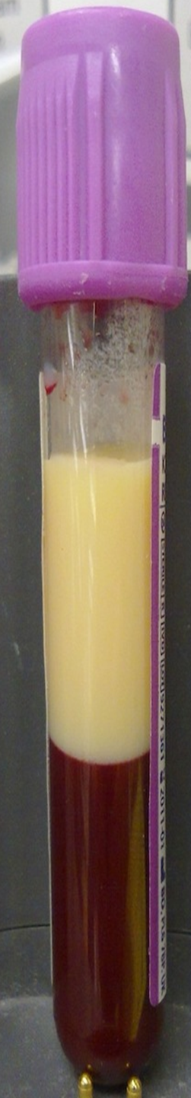


Example of Valid and Invalid Plasma Samples
Valid serum and plasma
Lipemic
Hemolyzed
Contaminated

Slide 12
Knowledge Check
What could cause a rejected specimen due to hemolysis?
  Shaking the specimen
  Too much fat in the blood
  Not enough anticoagulate
  Not enough blood in the spot
√

Slide 13
Knowledge Check
What causes lipemic blood specimens?
  Shaking the specimen
  Too much fat in the blood
  Not enough anticoagulated
  Contamination of the blood
√

Slide 14
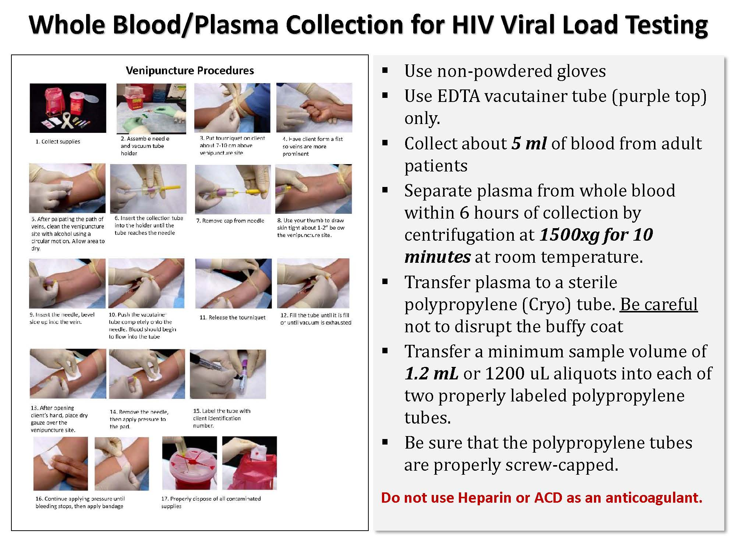

Plasma using Venous Blood
Handout
3-1

Slide 15
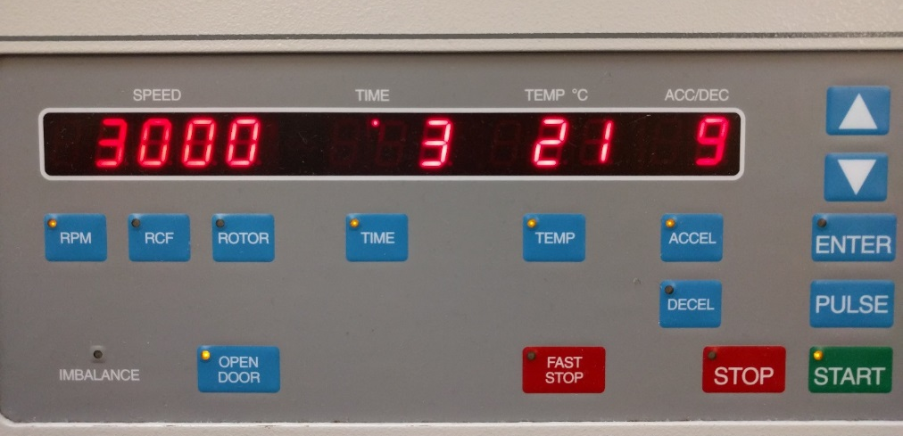
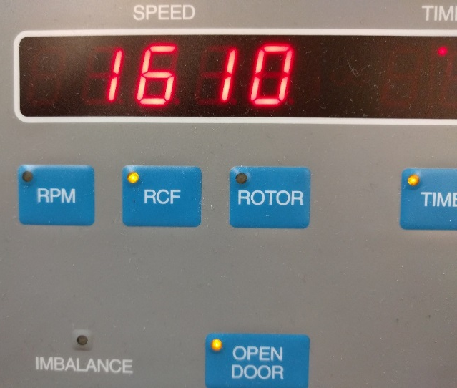
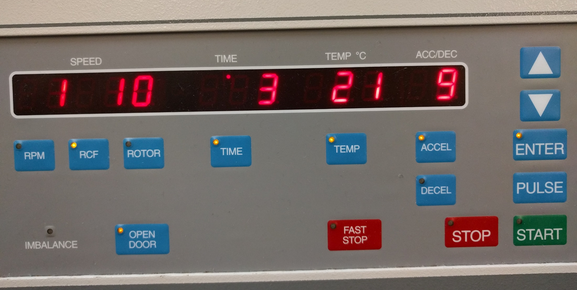
Centrifugation of Whole Blood into Plasma
RPM varies by centrifuge and rotor, g force does not. Always use xg as it is standardized
Proper speed =1500 x g for 10 minutes
Ensure the centrifuge is maintained and calibrated

Slide 16
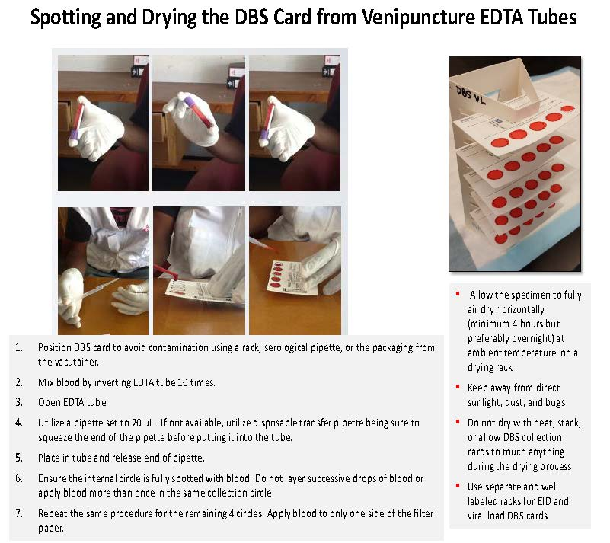
Handout
3-2

Slide 17
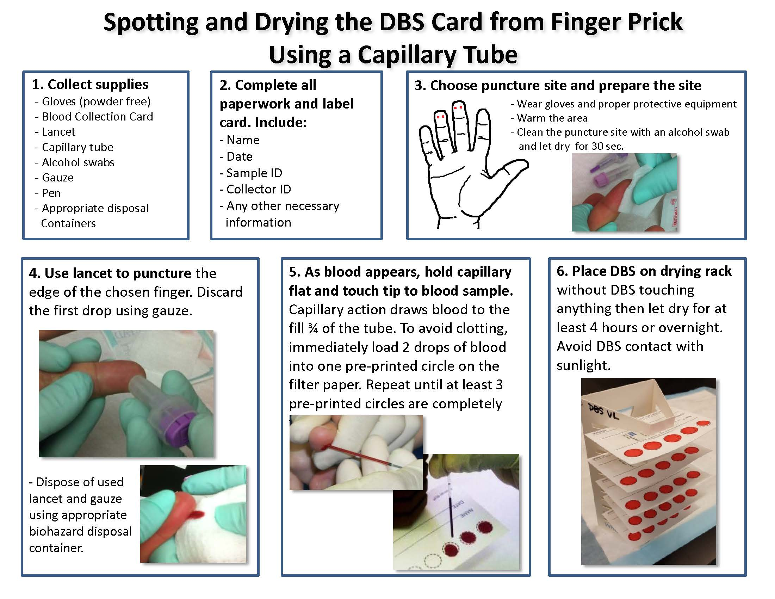
Handout
3-3

Slide 18
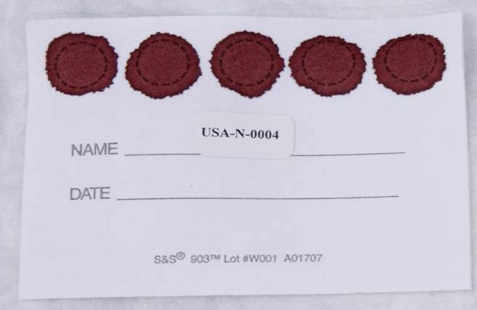
A Valid DBS Specimen
10/20/2004
Patient ID is present along with the date
Spots are completely filled
3 complete circles
are better than 5
incomplete ones!!

Slide 19
Activity 3A: Is this DBS Valid?
Purpose
To distinguish between acceptable and unacceptable DBS specimens for viral load testing
What will you need?
Pen and notepaper
What will you do?
Work individually:
  Review the DBS specimens on the next slide and determine for each specimen whether it is “valid” or “invalid”.
  Record your answer on a piece of paper
  Participate in large-group discussion.
3 minutes

Slide 20
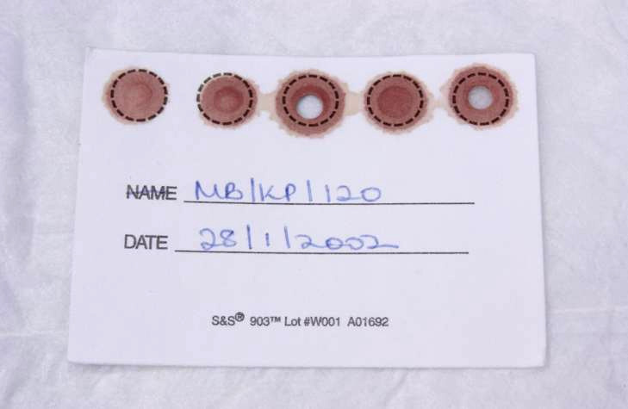

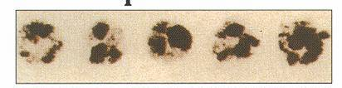
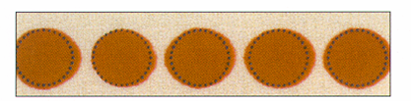
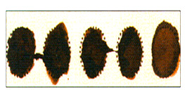
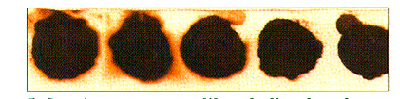
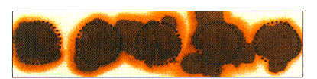
Activity 3A: Is this DBS Valid?
❶
valid / Invalid?
❷
valid / Invalid?
❸
valid / Invalid?
❹
valid / Invalid?
❺
valid / Invalid?
❻
valid / Invalid?

Slide 21
Activity: Valid or Invalid ?
❶
Valid!
Patient ID is present along with the date
Spots are completely filled
From an anemic patient

Slide 22
Activity: Valid or Invalid?
❷
Invalid!
Spots are not completely filled
Possibly directly from fingerstick

Slide 23
Activity: Valid or Invalid?
❸
Trick question!
This card appears to not yet be dry
The spots are valid but it is not yet ready to be packaged

Slide 24
Activity: Valid or Invalid?
❹
Invalid!
Clotting seems to have occurred

Slide 25
Activity: Valid or Invalid
❺
Invalid!
This card look contaminated possibly with alcohol

Slide 26
Activity: Valid or Invalid
❻
Invalid!
These spots exhibit serum rings
Could be due to:
  not mixing EDTA tube appropriately
  Milking or squeezing fingerstick site excessively

Slide 27
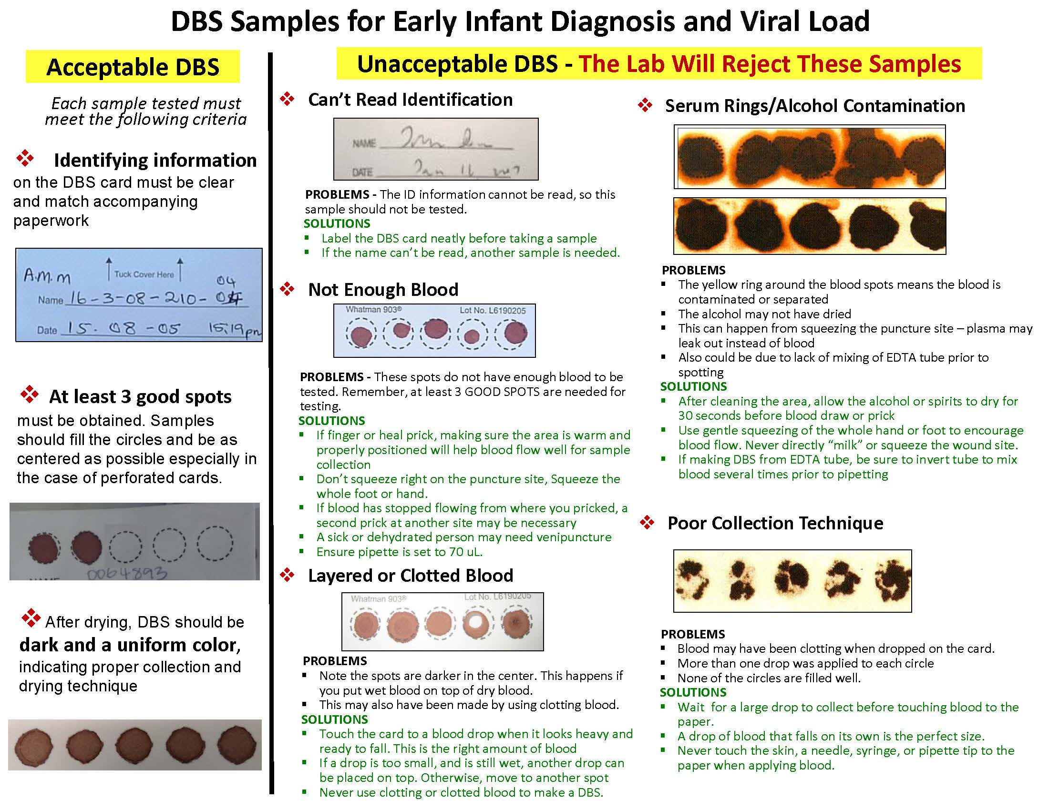
How to Prevent Unacceptable DBS Samples?
Handout
3-4

Slide 28
Recommended vs. Minimum Specimen Volume for Viral Load Testing
 | Recommended* | Minimum below which specimen will be rejected
Whole Blood (EDTA tubes) | 5 mL | 3.5 mL
Plasma | 2.4 mL | 1.5 mL
Dried Blood Spots | 5 filled spots | 2 filled spots
*In case of instrument failure or operator errors and retesting is needed

Slide 29
Knowledge Check
What is the preferred container to collect whole blood via venipuncture for viral load testing?
  Heparin tubes
  ACD tubes
  PPT tubes
  EDTA vacutainer tubes
√

Slide 30
Knowledge Check
For viral load testing, what is the ideal time from blood collection to centrifugation and separation of plasma?
  6 hours
  8 hours
  12 hours
  24 hours
√

Slide 31
Knowledge Check
Which type of centrifugation measurement varies by centrifuge and rotor?
  RCF
  xg
  RPM
  Momentum
√

Slide 32
Knowledge Check
How many times should you invert the whole blood sample to ensure proper mixing prior to blood spotting?
  5
  6
  10
  20
√

Slide 33
Knowledge Check
If using a pipette for spotting blood from an EDTA tube for DBS, what volume should the pipette be set to?
  100 uL
  70 uL
  50 uL
  30 uL
√

Slide 34
Specimen Packaging and Transport

Slide 35
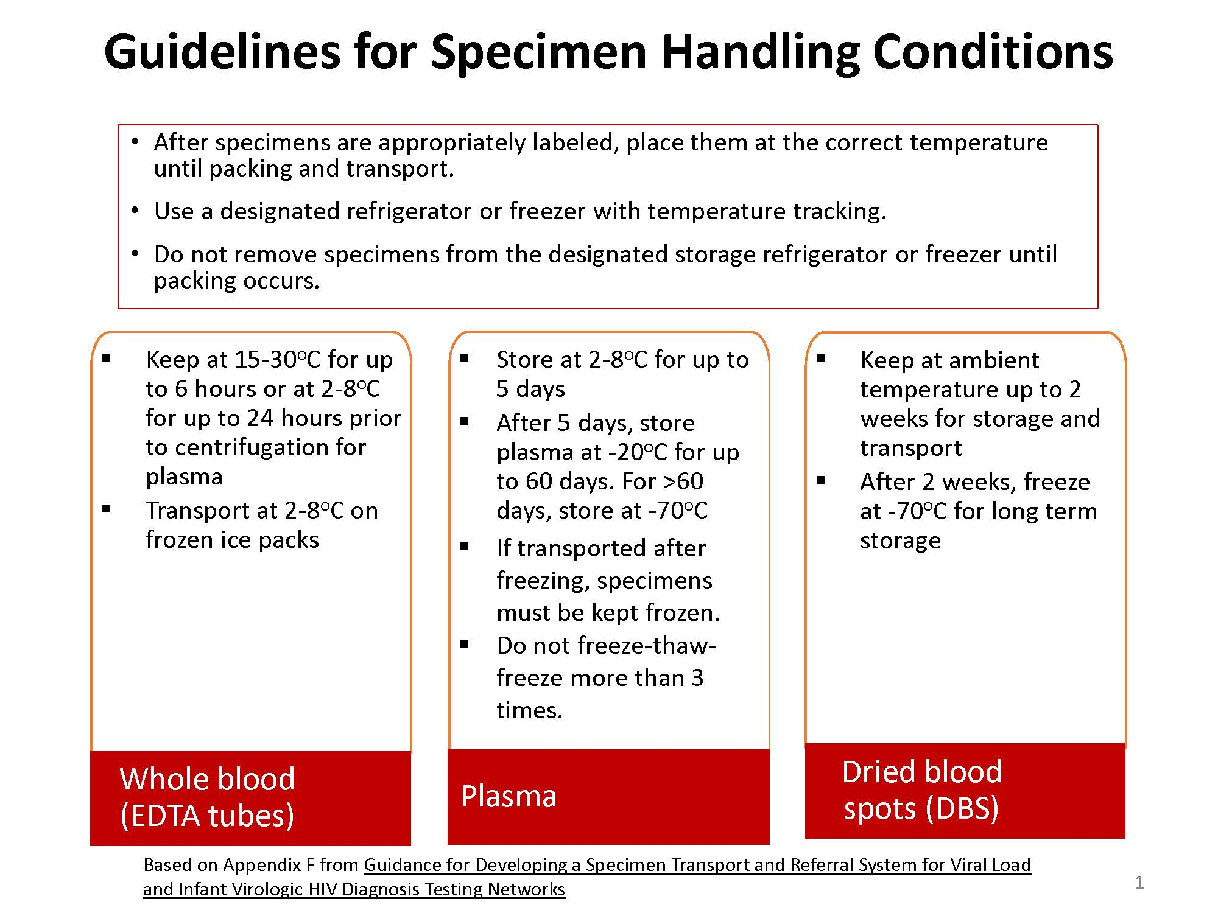
Handout
3-5

Slide 36
Packaging Viral Load Samples for Transportation
All specimens should be transported following as closely to the regulations put forth by the local and country regulations
  when possible, following the International Air Transporter Association (IATA)
Plasma should be triple packaged in an airtight container and kept frozen
DBS are considered non-infectious but should also be triple packaged

Slide 37
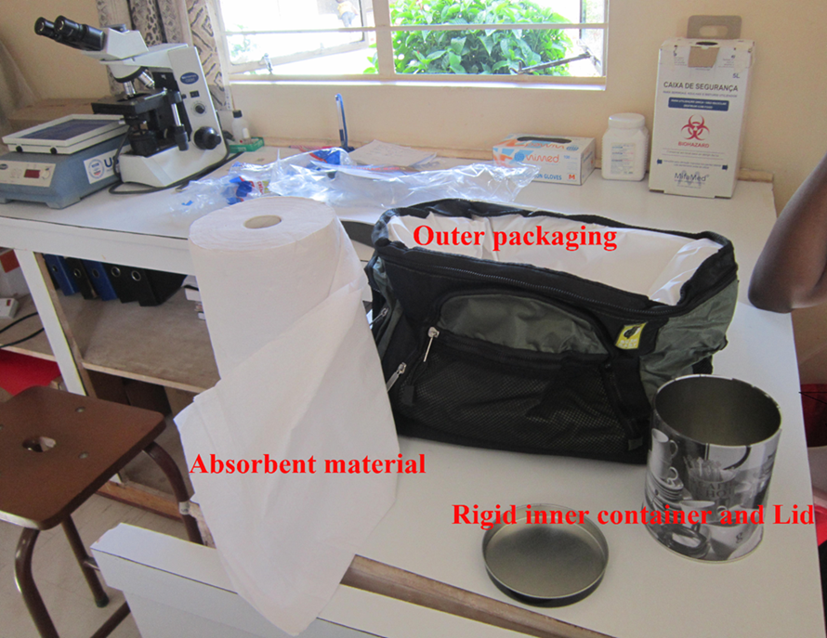
Example of Triple Packaging System
Handout
3-6

Slide 38
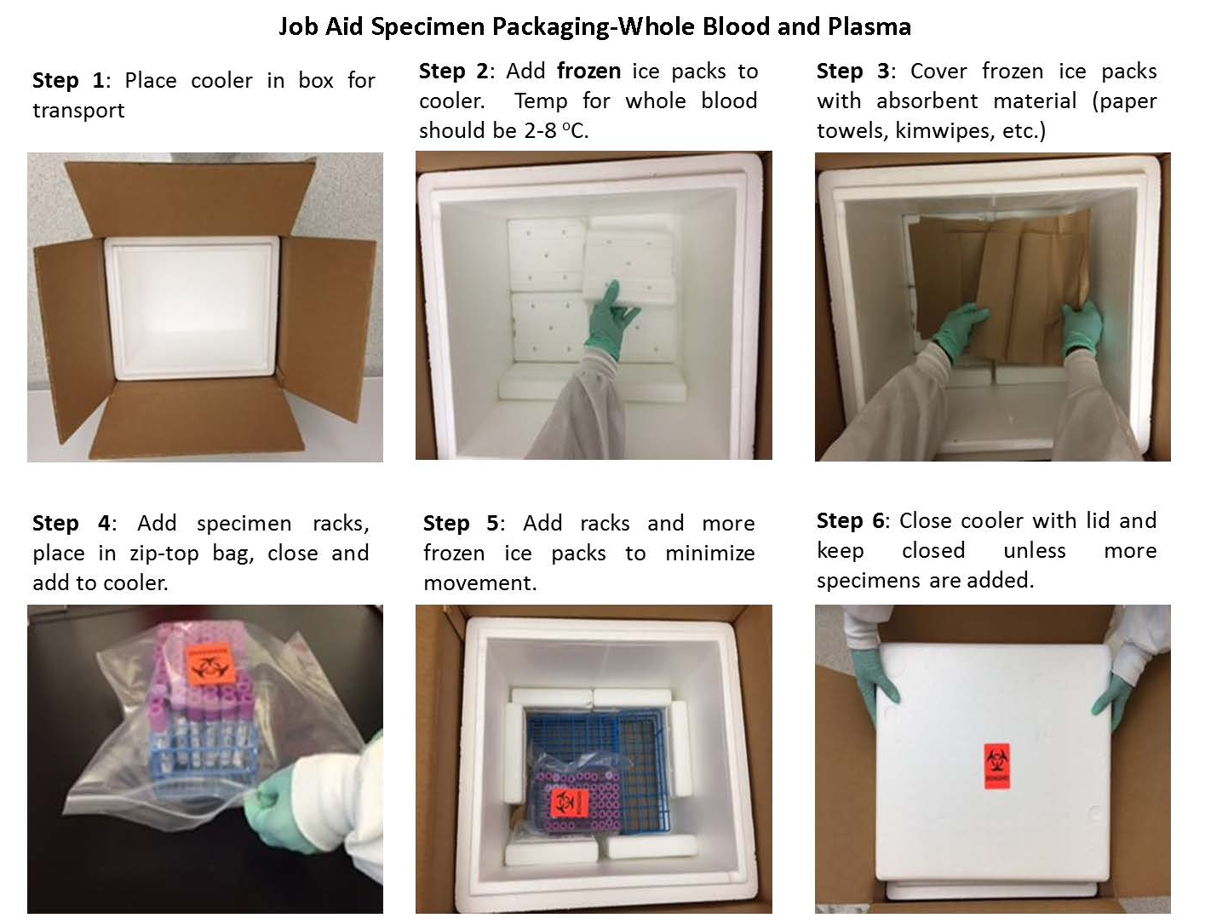
Packaging Whole Blood and Plasma for Transport
Handout
3-7

Slide 39
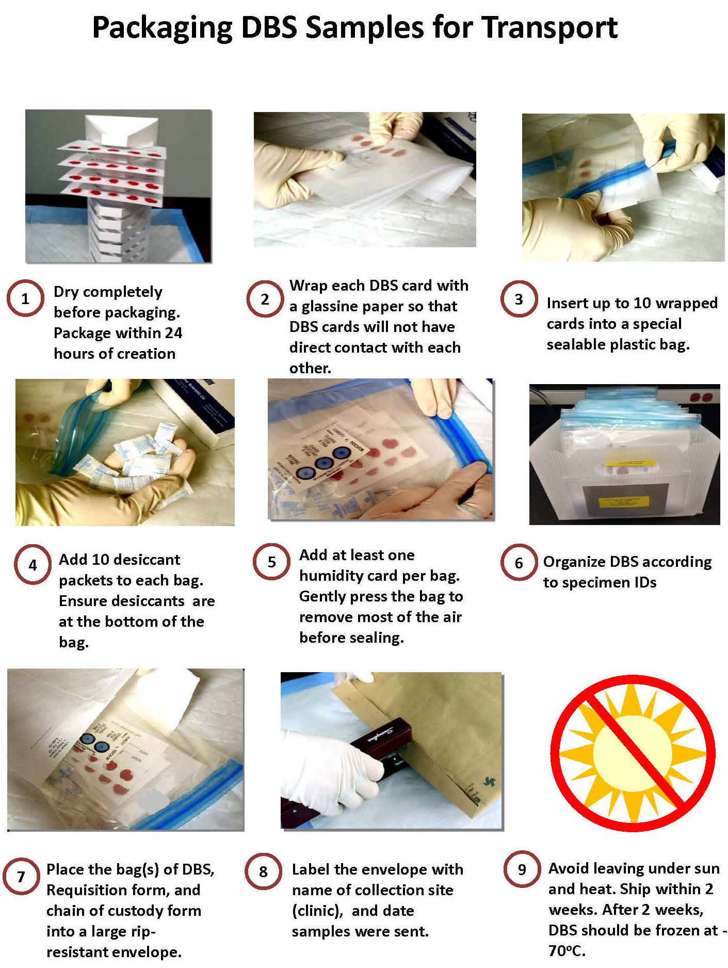
Handout
3-8

Slide 40
Activity 3B: Packaging Specimens for Shipment to Referral Sites
Purpose
To safely and effectively package specimens using the supplied packing materials.
What will you need?
Handout 3-6: Triple Packaging System (3 pages)
Handout 3-7: Job Aid Specimen Packaging – Whole Blood and Plasma
Specimens and packaging supplies
What will you do?
Divide into 3 groups and go to your assigned send-out work stations.
  Each group will have 15 minutes to package specimens with the supplied packaging materials using Job Aids as a guide.
  Participate in group discussion
Handout
3-6, 3-7
20 minutes
Notes:
40

Slide 41
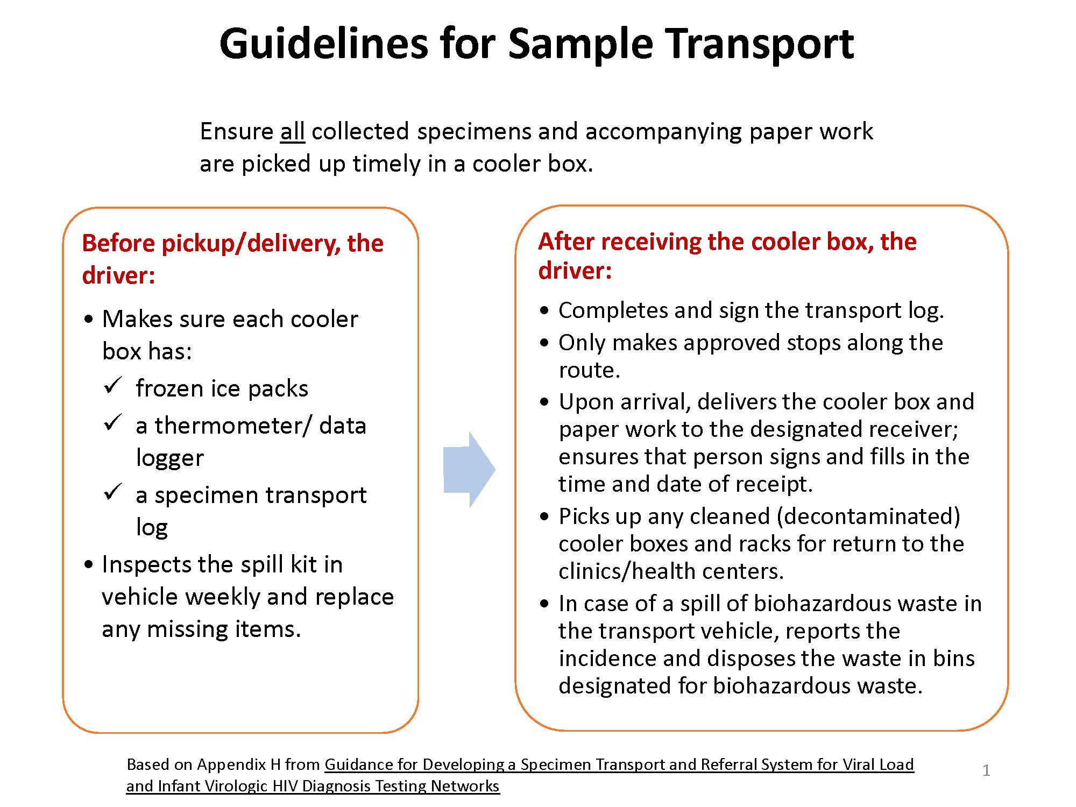
Handout
3-9

Slide 42
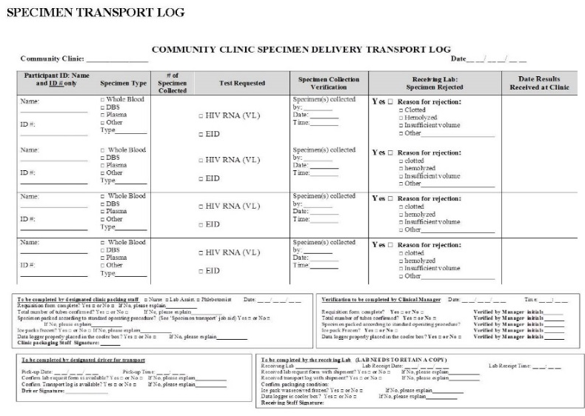
Chain of Custody for Sample Transport
Track specimens from collection site to the testing laboratory at each hand-off point
Use a transport log that includes date and time of receipt/pick-up and the name of the receiving individual/person picking up (including driver)
Handout
3-10

Slide 43
Knowledge Check
How long can plasma be stored at 2-8ºC?
  6 hours
  24 hours
  5 days
  2 weeks
√

Slide 44
Knowledge Check
DBS if packaged properly can be stored at ambient temperature for up to 2 weeks and can be transported at this same temperature.
  True
  False
√

Slide 45
Knowledge Check
Transport documents must be filled to maintain and prove chain of custody. At every hand off point in the process, _________, _________, and _________ must be recoded on the transport log.
signature
date
time

Slide 46
Specimen Tracking

Slide 47
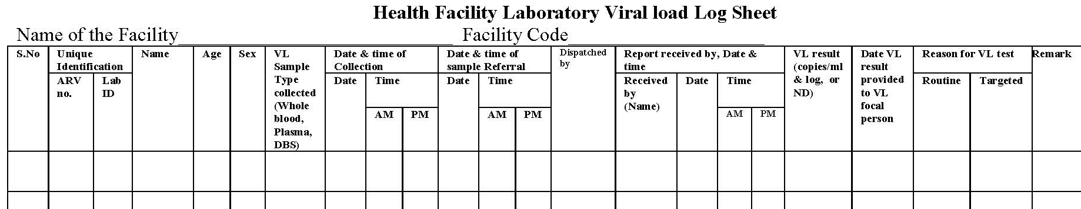
Keeping Track of All Referral Samples at Clinics
Health clinics should assign a designated person to:
Follow up with the designated persons at each transport point as well as the end point (test sites) to ensure all samples sent have arrived
Check # of results returned against # of samples referred on a weekly basis
Handout
3-11

Slide 48
Clinics Should Routinely Track These Indicators
# specimens collected at site (per day/week)
# specimens transported from site (per day/week)
# results received from VL testing lab (per day/week)

Slide 49
Specimen Rejection Criteria

Slide 50
Activity 3C: Sample Rejection Criteria
Purpose
To develop rejection criteria for each sample type for viral load testing.
What will you need?
Flipchart paper
What will you do?
Divide into 3 groups - each group will be assigned one type of specimen: whole blood, plasma, or dried blood spots.
  Discuss within your group criteria to be used to reject a specimen
  Write your rejection criteria on a flipchart
  Participate in large-group discussion
20 minutes
Notes:
50

Slide 51
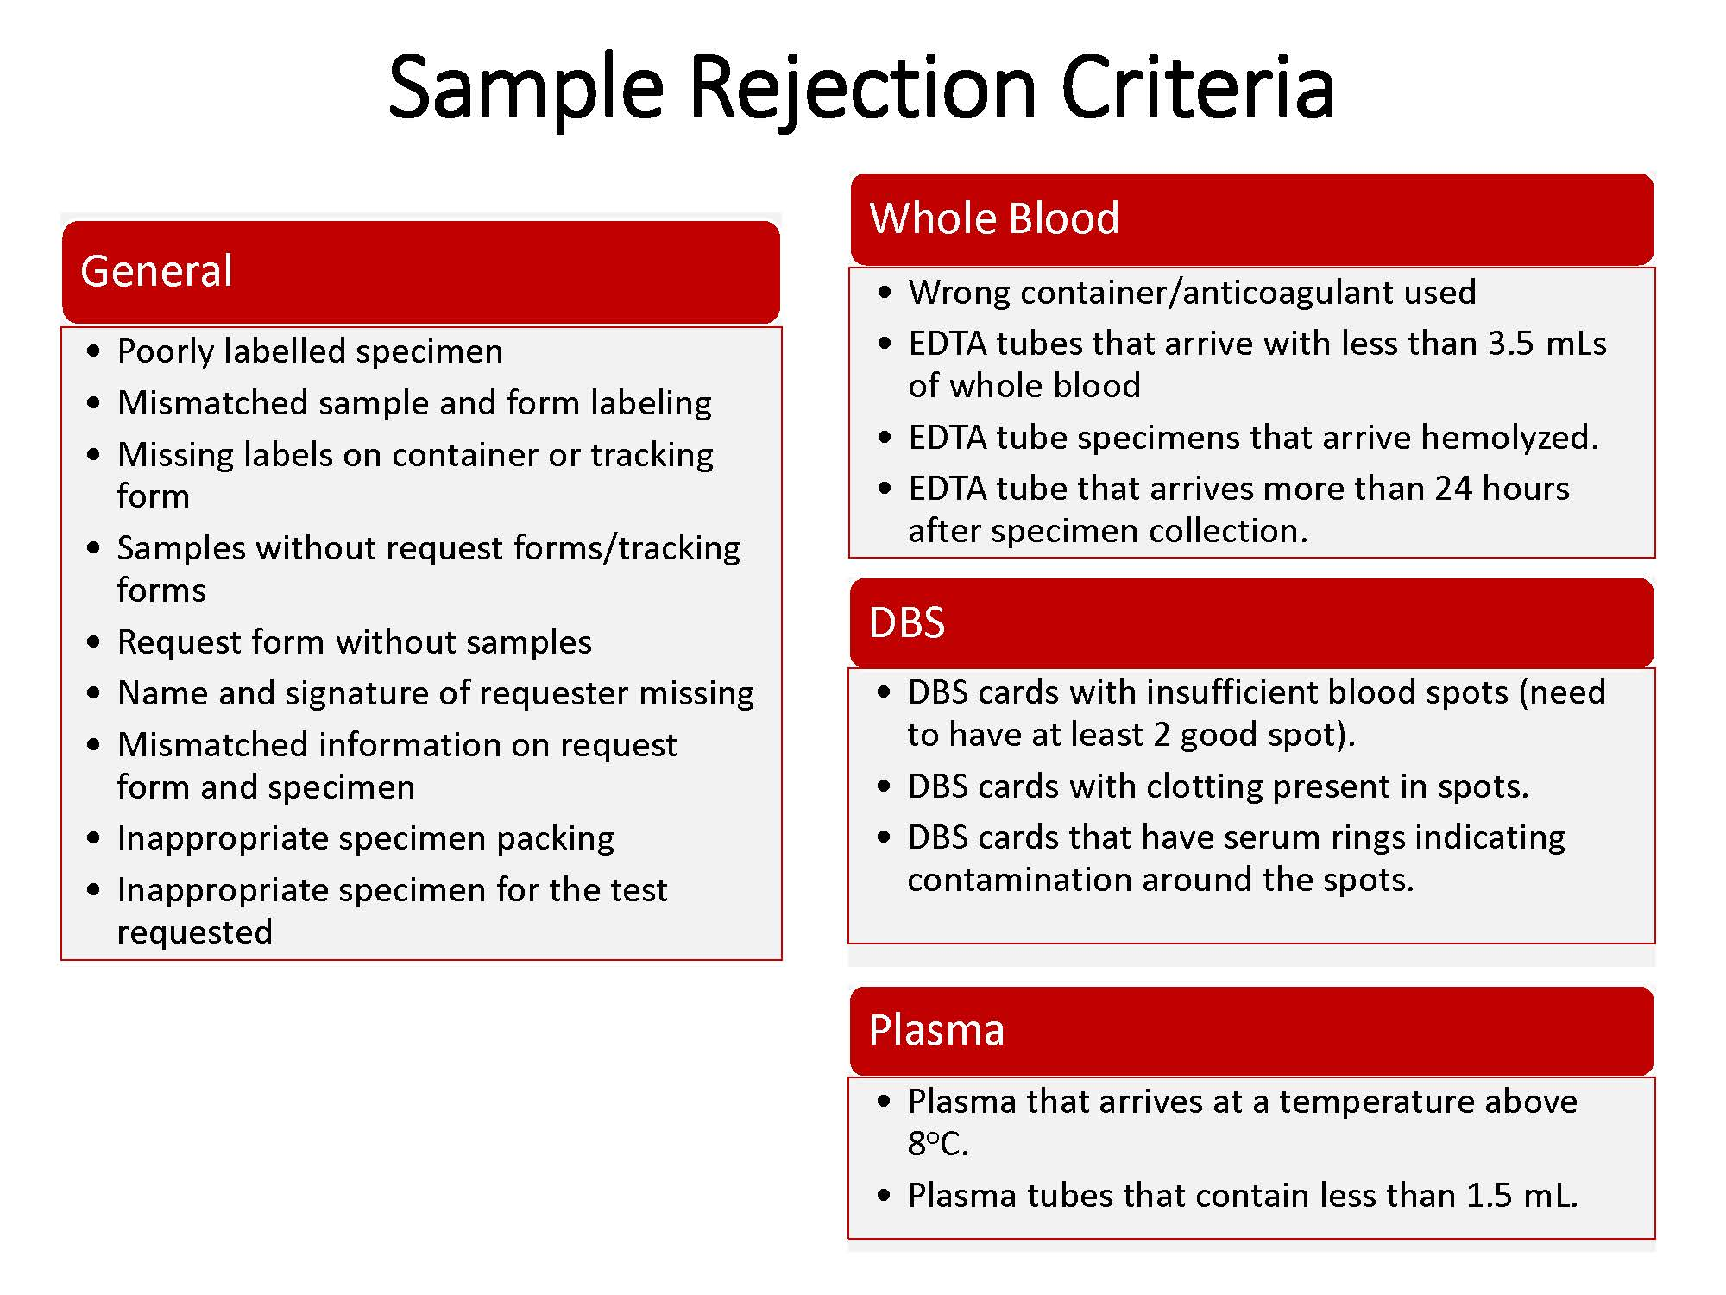
Handout
3-12

Slide 52
Making and Packaging DBS from EDTA Tubes
A Practical Session
Notes:
1) have participant review the job aid for packaging DBS as overnight homework. 2) pair participants up have them observe/critique each other. 3) debrief as a whole class and discuss mistakes seen, etc. Conclude the activity by going over the job aid to make sure everyone clearly understands the steps.

Slide 53
Key Messages
Specimen ________ is key to the accuracy of the viral load test results.
Viral load samples may be collected as whole blood for processing into ______ or ______
Proper ______, ______, ______, ______, and ______ of viral load specimens is essential
During sample transport, the correct ______ must be monitored and maintained for each specimen type
______ of ______ is key to ensure proper specimen handling during transport
Regular ______ of referral samples is crucial in making sure all results are returned
If a specimens meets any of the ______ ______ ______, it cannot be used for viral load testing.

Slide 54
Key Messages
Specimen integrity is key to the accuracy of the viral load test results.
Viral load samples may be collected as whole blood for processing into plasma or DBS
Proper collection, processing, storage, packaging, and transport of viral load specimens is essential
During sample transport, the correct temperature must be monitored and maintained for each specimen type
Chain of custody is key to ensure proper specimen handling during transport
Regular tracking of referral samples is crucial in making sure all results are returned
If a specimens meets any of the sample rejection criteria, it cannot be used for viral load testing.

