Slide 1
Module 6: Enhanced Adherence Counselling (EAC)
DRAFT
Suitable for Clinicians and Counsellors

Slide 2


Module 6: Objectives
Conduct enhanced adherence counselling sessions for patients with a high viral load following a structured approach
Work with patients to identify barriers to adherence and strategies to overcome them
Document EAC sessions in EAC Logbook and High Viral Load Forms
Monitor the EAC Compliance and Quality

Slide 3
What is EAC?
Why is it important?

Slide 4
Enhanced Adherence Counselling (EAC) is…
A structured counseling intervention with the aim to support patients to achieve viral suppression
  Targets patients with viral load >1000 copies/mL
  Helps patients identify problems that influence their adherence and find appropriate solutions
  Helps rule out the possibility of poor adherence before switching to 2nd line ART
Time allocated for each session: 30-45 minutes

Slide 5
EAC Has Been Shown to Keep Viral Load Suppressed in Some Patients
In resource-limited settings,
30%-60% patients achieved viral suppression after EAC (Ellman 2014; Jobanputra 2014; Patten 2013)
These intervention programs vary widely (high vs low-volume sites, available HR, etc.)
However, they share a few similarities:
  Structured intervention
  Supported by implementation tools like session guide, patient file and register

Slide 6

Activity 6A: Role Play on Attitudes
Purpose
To identify behaviors, attitudes, or approaches that may be counter-productive in problem solving.
What will you need?
Paper and pen for notetaking
What will you do?
  Given the scenario on the next slide,
  Observe the role play of a facility manager and a nurse interacting under stressful circumstances at this busy clinic
  Participate in class discussion
5-min role play + 25-min discussion
Handout
6A.1
Notes:
6

Slide 7
Here is the situation…
[Volunteer 1] is the facility manager of a very busy clinic. His/her manager called this morning and said the clinic is not meeting targets, so he/she is very stressed. It’s the day after a public holiday so the clinic is especially busy today. One nurse had already called in sick. The other nurse [Volunteer 2] has been late several times in the past, and frequently leaves early. She always has child care issues. She is 2 hours late for work today.
Watch what happens next when the nurse finally arrives at work….

Slide 8
Appropriate Attitudes and Behaviors for EAC
It helps to … | Instead of saying… | Try saying…
Adopt a non-judgmental attitude | “What have you done wrong?” | “What makes it challenging for you to take drugs every day?”
Empower patients | “You should take your drugs every day as I tell you to do.” | “Well done, your viral load is suppressed, keep up the good adherence.”
Use open-ended questions | “Did you take your drugs last night?” | Can you tell me how you have been taking your drugs over the last days?”
Work on realistic solutions | “You should never stop taking drugs when you travel” | “Let’s see how we can ensure you do not run out of drugs when you travel. What do you think about coming to the health facility for a longer supply before you leave for your trip to see your family?”

Slide 9
Activity 6B: Identifying Adherence Barriers
Purpose
To explore the reasons why patients are unable to adhere to their treatment.
What will you need?
Flipchart paper and markers
What will you do?
  Work in groups of 4-6 (10 minutes):
  Brainstorm possible barriers that prevent patients from adhering to their treatment.
  Prepare a flipchart listing all barriers generated in your group discussion
After the brainstorm, each group takes turns reading out loud a barrier on their flipchart and categorizing it according to the next slide (10 minutes)
20 minutes
Notes:
9

Slide 10
Categories of Adherence Barriers
  Knowledge
  Information
  Perception
  Motivation
  Experience of side effects
  Life conditions
  Degree of social support
  Stigmatisation
  Financial means
Cognitive
Social-economic
Behavioral
Emotional
  Skills
  Routines
  Habits
  Depression
  Anxiety
10
Notes:
10
10

Slide 11
Activity 6C: Overcoming Adherence Barriers
Purpose
To identify actions and strategies to counter the four categories of patient-related adherence barriers.
What will you need?
Flipchart paper and markers
What will you do?
  Work in groups of 4-6 (10 minutes):
  Brainstorm possible strategies and actions to overcome each type of patient-related adherence barriers.
  Prepare a flipchart listing all actions and strategies (by the four barrier categories) generated in your group discussion
  Select a spokesperson to make a 2-minute presentation
20 minutes
Notes:
11

Slide 12
Overcoming Adherence Barriers
  Re-educate patients on HIV and ART
  Clarify mis-understanding
  Income generating activities
  Community support
  Peer group
Cognitive
Social-economic
Behavioral
Emotional
  Identify reminder tools
  Help patients develop routines
  Train patients to plan ahead
  Depression screening
  Referral
  Basic emotional support
12
Notes:
12
12

Slide 13
Activity 6D: Agree or Disagree?
Purpose
To determine statements about adherence are correct or incorrect.
What will you need?
Your body
What will you do?
  Given a statement projected on the screen, determine whether you agree or disagree with that statement. Move your body accordingly to one side (“agree”) or the other (“disagree”) as labeled by the facilitator.
  Participate in class discussion
10 minutes
Notes:
13

Slide 14

Agree or Disagree?
You cannot drink alcohol when taking ARVs
Taking your drugs 10 minutes late will cause resistance
It is okay to take drugs on an empty stomach
Dosing time may be changed during fasting
Unprotected sex is not a common reason for a high viral load
Patients should be obliged to disclose their status
You need to continue to take drugs daily, even when your viral load is undetectable
Handout
6-1

Slide 15
When and how is EAC done?

Slide 16

EAC Sessions
When does EAC happen?
  VL ≥ 1000 copies/mL
Month 0
  EAC session #1
  Viral load result given
  1 month refill given
Month 1
  EAC session #2
  1 month refill given
Month 2
Adherent?
Yes
No
Month 3
  Additional EAC session
  1 month refill given
Handout
  Follow-up VL test ordered
6-2

Slide 17
EAC Session Overview
EAC Session #1
1. Welcome and introduction
2. Give & explain the viral load result
3. Explain EAC
4. Assess previous and current adherence
5. Explore barriers to adherence and identify ways forward (behavioral, socio-economical, emotional)
6. Conclude the session
EAC Session #2
1. Welcome and introduction
2. Assess patient’s adherence since last visit
3. Evaluate implementation of solutions to adherence barriers
4. Explain next steps in the EAC process
5. Conclude the session
Handout
6-2

Slide 18
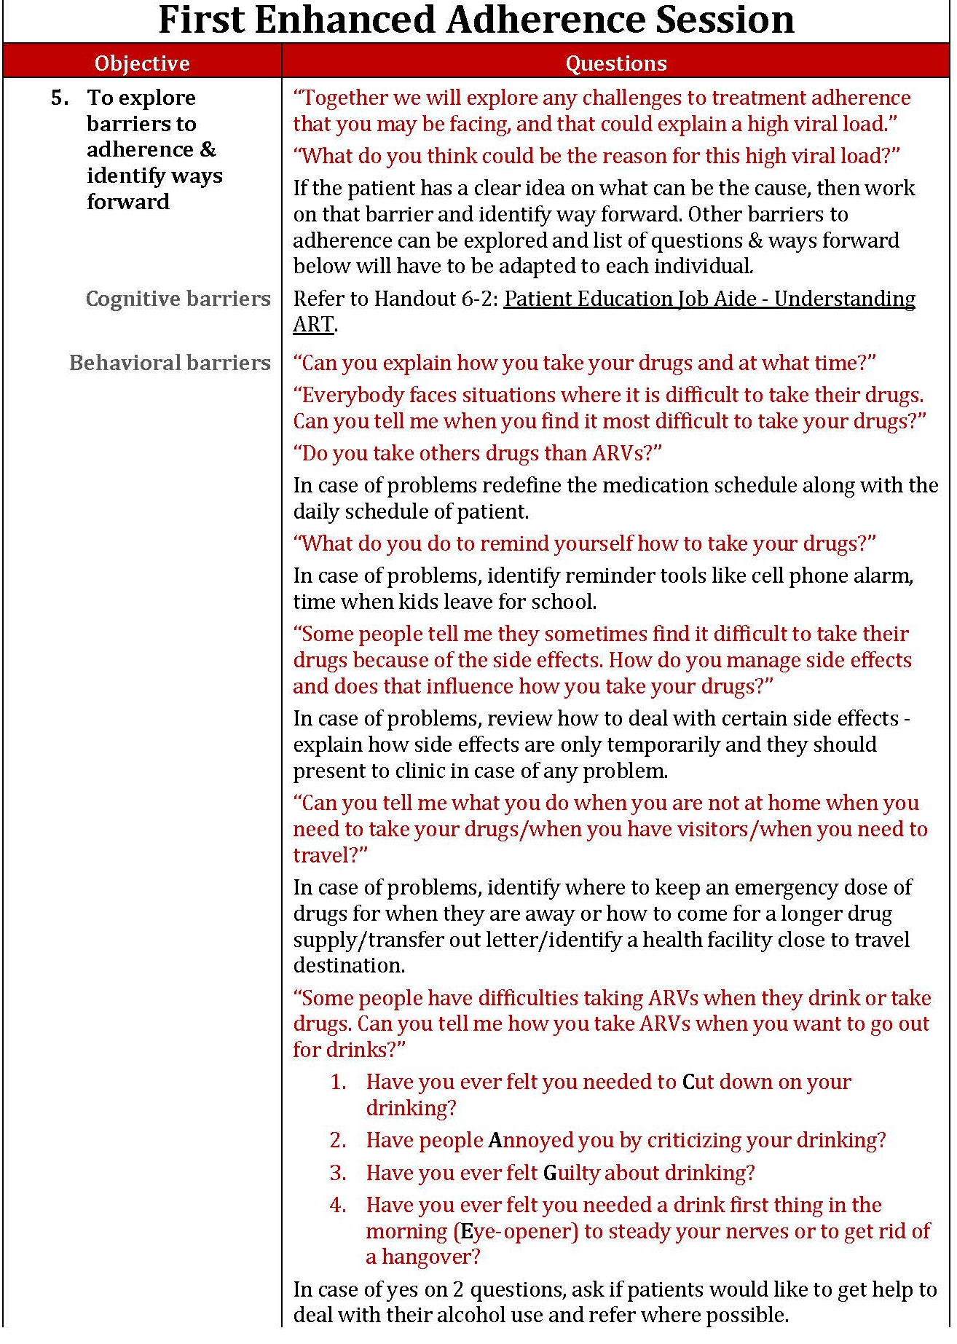
Step 5 – Explore Barriers to Adherence & Identify Ways Forward
Cognitive
Social-economic
Behavioral
Emotional
Handout
6-2

Slide 19
Monitoring EAC Compliance and Quality

Slide 20
Three Tools to Monitor Facility and Patient Compliance with EAC
❶
❷
EAC Logbook
High Viral Load Forms (in patient files)
❸
EAC session observation checklist

Slide 21
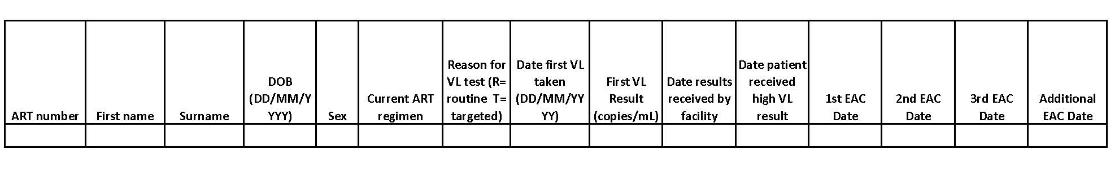
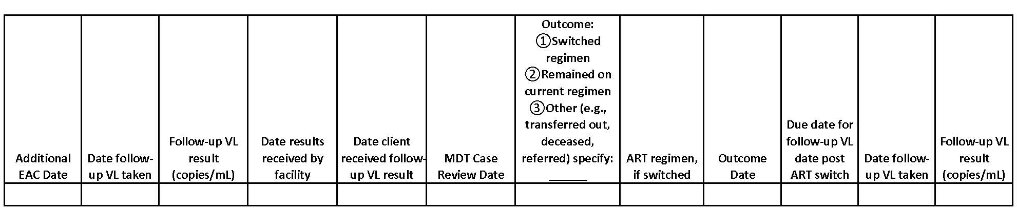
EAC Logbook
Tracks all patients with a high viral load
Makes sure they receive:
  Enhanced Adherence Counselling
  Follow-up viral load test
Handout
6-3

Slide 22
High Viral Load Form
Records barriers and ways forward that were discussed in EAC sessions
Facilitates communication with the health care provider
Must be placed in the patient’s file
Handout
6-4

Slide 23
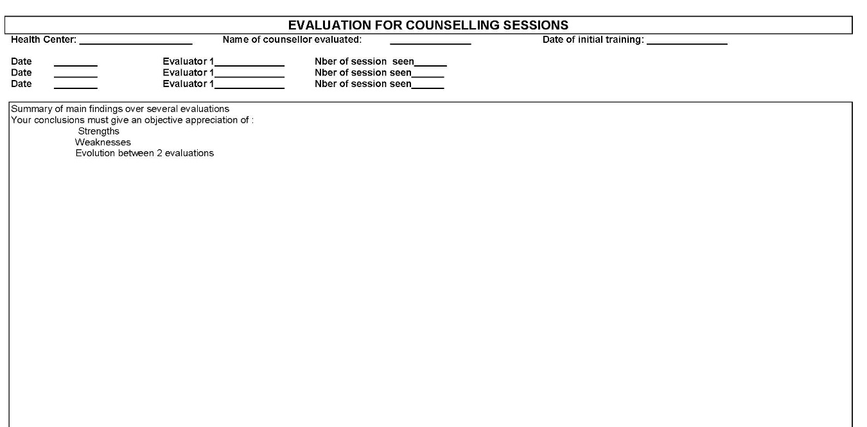
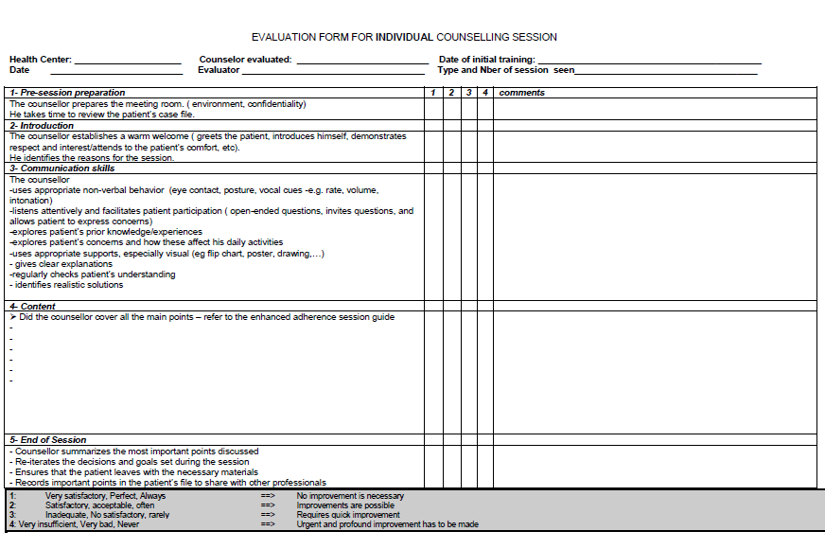
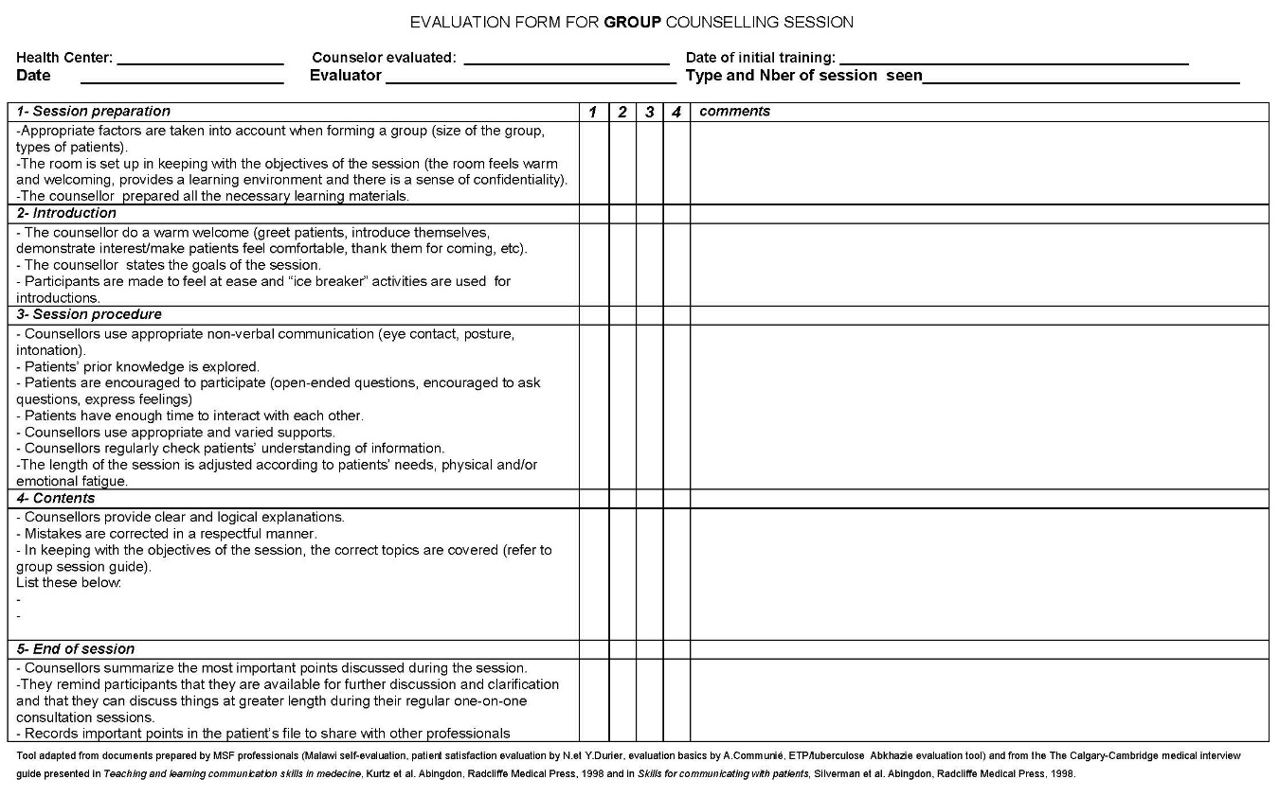
EAC Session Observation Checklist
Page 1 – Cover Sheet
Page 2 - Evaluation Form for Individual Counselling Session
Page 3 - Evaluation Form for Group Counselling Session
Handout
Objective: > 80% of counsellors have a satisfactory score
6-5

Slide 24
Knowledge Check
The best way to identify which patients have been missing EAC sessions is by reviewing which document?
  EAC Logbook
  EAC Session Observation Checklist
  High Viral Load Form
√

Slide 25
Reviewing the EAC Logbook Helps Assess Patient Compliance with EAC and its Impact
Objective:
> 80% of patient attend at least one EAC session

Slide 26
Knowledge Check
Upon completion, each EAC session must be recorded where? Check all that apply.
  EAC Logbook
  EAC Session Observation Checklist
  High Viral Load Form
√
√

Slide 27
Knowledge Check
Reviewing what document will help you determine if the an EAC session has achieved its objective?
  EAC Logbook
  EAC Session Observation Checklist
  High Viral Load Form
√

Slide 28
Reviewing the High Viral Load Forms in Patient Files
  Have the different steps been followed?
  Has the main problem been identified?
  Has a way forward been identified?
  Is the documentation complete and in alignment with the EAC logbook?

Slide 29
Activity 6E: Reviewing an EAC Logbook
Purpose
To asses facility and patient level compliance with EAC through reviewing the EAC Logbook.
What will you need?
6E.1: Sample EAC Logbook
6E.2: Record Sheet for EAC Logbook Review Findings
What will you do?
Work in teams of 2,
  Review a sample EAC Logbook and identify patients that require follow-up action.
  Brainstorm follow-up action required.
  Document your findings using Worksheet 1.
  Participate in class discussion
Handout
15 minutes
6E.1 & 6E.2
Notes:
29

Slide 30
Activity 6E: Reviewing an EAC Logbook
 | Patient ID | Acceptable? | Comments and Concerns
1 | 238210 | Yes | VL suppressed after 2 EAC
2 | 101229 | No | Delay in patient receipt of first high VL
3 | 237513 | No | Only one EAC visit without follow-up EAC; repeat VL very delayed (suboptimal); MDT case review led to decision to keep patient on current regimen and offer patient additional EAC because patient adherence in the long interim between EAC and follow-up VL could not be verified and patient is already on 2nd line treatment (this would be a thoughtful and logical management decision for this suboptimal scenario)
4 | 259735 | Yes | Timely follow-up of patient along every step of cascade with complete documentation of EAC sessions and appropriate management of ART regimen switch with optimal outcome
5 | 126402 | No | No follow-up VL drawn after completion of EAC sessions
6 | 180068 | No | No documentation of outcome (e.g., ART regimen switch) after MDT case review
7 | 213173 | No | Lost to follow-up after first high VL result
8 | 309875 | Yes | Patient on second line therapy with first high VL received EAC and follow-up VL was suppressed
9 | 243571 | No | VL result never returned to facility and no follow-up documented
10 | 296873 | Yes | Received additional EAC sessions as needed, well-documented in logbook, follow-up VL was timely and suppressed, patient notified of results, no need for MDT review
Notes:
30

Slide 31
Activity 6F: Reviewing High Viral Load Forms
Purpose
To determine the quality of the EAC sessions attended by two patients by reviewing their High Viral Load Forms
What will you need?
6E.1: Sample High Viral Load Forms
What will you do?
Work in teams of two,
  Review the High Viral Load Form for Patient A and Patient B; evaluate the quality of their EAC sessions.
  Answer the questions:
    Were any key steps missed?
    Have the main problems been identified?
    Has a way-forward been identified?
    Are the forms complete?
  Participate in class discussion
Handout
6F.1
10 minutes
Notes:
31

Slide 32
Activity 6F: Reviewing High Viral Load Forms
Pt # 348624
Pt # 3496781
Clear documentation of:
Barriers and specific details of challenges
Suggestions for addressing barriers
Response to interventions and additional suggestions with details of frequency of missed doses
Details of barriers remaining after EAC
Plan for ARV regimen after EAC
Poor documentation of barriers identified during EAC sessions
No documentation of interventions or suggestions to address barriers
Poor documentation of any change inpatient behavior
Incomplete documentation of pill count
Incomplete documentation of barriers remaining after EAC which portrays incomplete picture of the patient

Slide 33
Activity 6G: EAC Session Role Plays
Purpose
To practice documenting and evaluating the EAC sessions using different tools.
What will you need?
6G.2 - Worksheet: High Viral Load Forms 6G.3 - Worksheet: Evaluation Form for Individual Counselling Session (1 copy)
What will you do?
Refer to Handout 6-2: Enhanced Adherence Counselling Session Guide and observe 3 role plays in plenary group. You will:
  As a supervisor - Assess the quality of the EAC in each of the three role plays by using the Evaluation Form for Individual Session.
  As a counsellor – At the end of each role play, record the session in the High Viral Load Form (one per patient)
Participate in class discussion after each role play
Handout
6G.1, 6G.2
90 minutes
Notes:
33

Slide 34
Role Play 1
The Situation
The patient is a 33-year old woman who has been on ART for 4 years. She has a viral load of 6000 copies/ml.
She always attends her appointments and picks up her drug refills on time.
This is her first EAC session.
Now watch the EAC session.

Slide 35
Role Play 2
The Situation
The patient is a 35-year old man, who often fails to attend for his appointments. He has a viral load of 15000 copies/ml.
According to the patient’s file, he travels often, which makes it impossible for him to come to his appointments.
This is his first EAC session.
Now watch the EAC session.

Slide 36
Role Play 3
The Situation
The patient is a 48-year old man, who started ART 3 years ago. His first viral load was 9500 copies/ml.
In the first EAC session, the patient told the counsellor he often drinks and that’s why he often forgets to take this medicine. As a way forward, the patient wants to ask a friend to remind him to take the drugs when out drinking.
This is his second EAC session.
Now watch the EAC session.

Slide 37
Module 6: Key messages
An enhanced adherence counselling intervention target _________________________and aims to help them ______________________.
EAC explores a patient’s ____________________and works with the patient to identify _____________.
During EAC, the counsellor must explore all 4 types of adherence barriers: ____________, ____________, ____________, and ____________.
EAC sessions must be documented using _______________ and ____________________.
A review of those documents helps you monitor _________________and ____________________.

Slide 38
Module 6: Key messages
An enhanced adherence counselling intervention target patients with high viral load and aims to help them achieve viral suppression.
EAC explores a patient’s barriers to adherence and works with the patient to identify a way forward.
During EAC, the counsellor must explore all 4 types of adherence barriers: cognitive, behavioral, emotional, and social-economic.
EAC sessions must be documented using the EAC Logbook and the High Viral Load Form.
A review of those documents helps you monitor the EAC coverage and the quality of the EAC sessions.

