Slide 1
Module 5: Educating Patients about Viral Load
DRAFT
Suitable for Clinicians and Counsellors

Slide 2
Module 5: Objectives
State the key messages to be communicated to patients about viral load
Identify the tools and patient education settings that can help spread key viral load messages

Slide 3

Shifting the paradigm from
CD4 to viral load

Slide 4
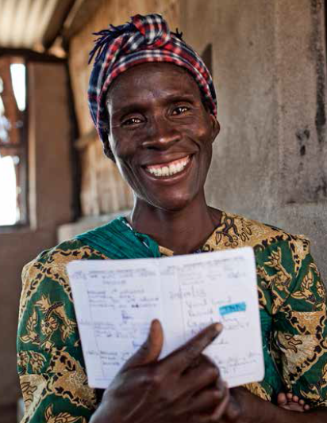
Why Do We Need to Educate Patients on Viral Load?
To reinforce adherence
«Your viral load is undetectable, which means you are taking your medicine correctly every day. Well done!»
To allow patients to request their viral load result
« Nurse, in my last visit you drew blood for viral load. I’d like to know if I am in good health, so could you please tell me my result? »

Slide 5
What do Patients Need to Know?
Nice to know
Essential to know
Keep It Simple!

Slide 6
Activity 5A: What Do Patients Need to Know About Viral Load?
Purpose
To identify what questions a patient might ask about viral load, or the topics that patient education must cover
What will you need?
Pen and post-it notes
Flipchart
What will you do?
Work in pairs and:
Brainstorm with your partner to list the top 3 questions or topics patient education must address
Write each question/topic on a post-it note and stick it to the flipchart
Participate in large-group discussion
5 minutes

Slide 7
Key Questions/Topics for Patient Education
What is viral load?
Why do you need a viral load test?
  What is the goal of ARV treatment?
  How do you know if your ARV treatment is working?
When should you have a viral load test?
What does your viral load result mean?
  low or undetectable viral load result
  high viral load result

Slide 8
Activity 5B: Key Messages for Viral Load for Patients
Purpose
To create clear, concise, and consistent key messages that communicate effectively with patients about viral load
What will you need?
Questions from the previous slide
Pen and post-it notes
Flipchart
What will you do?
Work in pairs and:
Brainstorm with your partner to create 3 key messages for patients education about viral load
Write each key message on a post-it note and stick it to the flipchart
Participate in large-group discussion
10 minutes

Slide 9
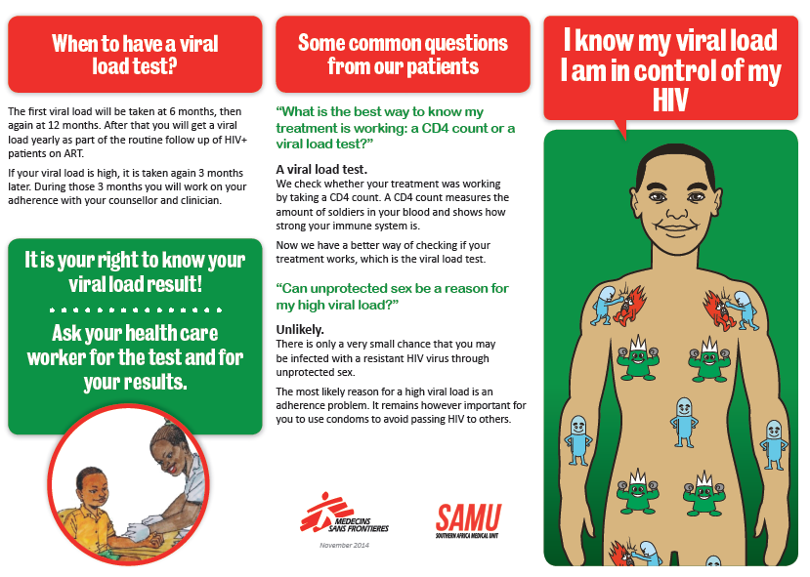
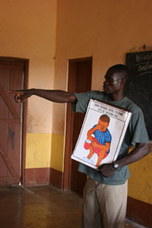
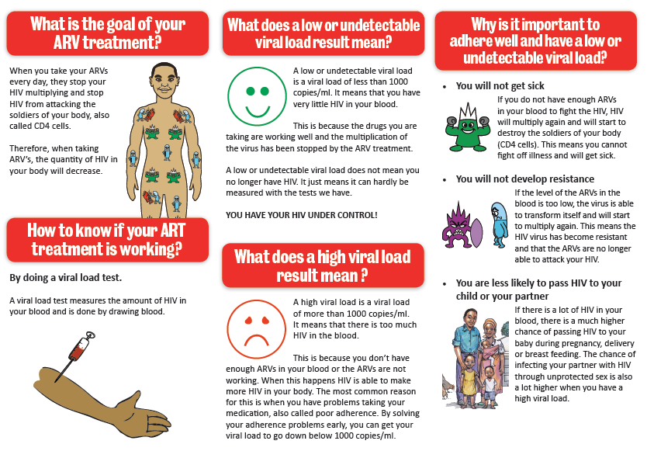

Tools for Patient Education
Viral load leaflets for literate patients
Education Flipchart
Stickers

Slide 10
Who Needs to Know About Viral Load Monitoring?
General
population
PLHIV
PLHIV initiating or on ART
PLHIV with VL >1000 copies/ml

Slide 11
How to Educate Patients about Viral Load Monitoring?
« New » on ART :
ART initiation counselling
« Old » on ART:
targeted patient education interventions
General
population
PLHIV
PLHIV initiating or on ART
PLHIV with VL >1000 copies/ml
Through enhanced adherence counselling

Slide 12
Patient Education on ART and Viral Load Testing
Day of
ART eligibility
Pre-ART group/individual
education session
Baseline CD4
Pre-ART individual session
Treatment readiness
group
Day of ART
initiation
ART initiation
individual session
Month 1
on ART
1st adherence followup
individual session
Prepare patients for viral load measurement between months 3 and 6
Month 2
on ART
2nd adherence followup individual session
Month 6
on ART
1st viral load
taken

Slide 13
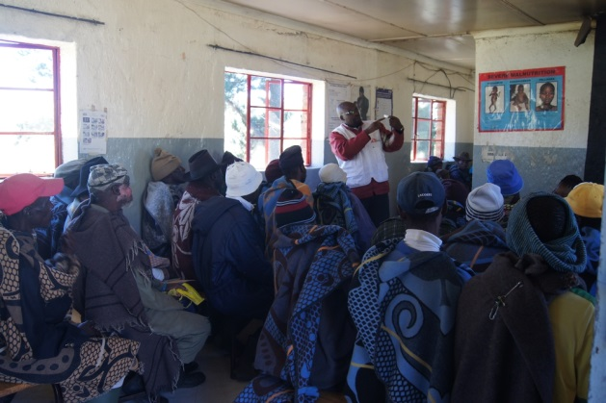
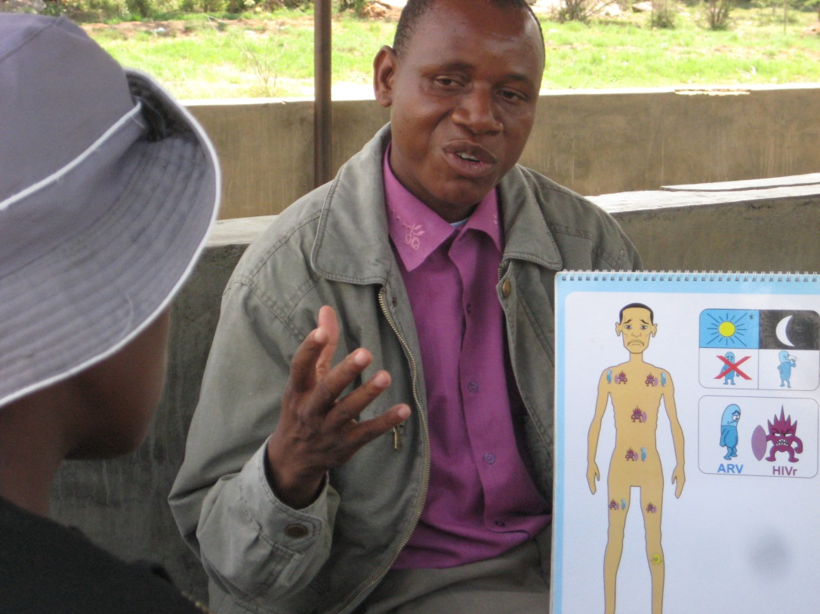
Other Settings for Patient Education

Slide 14
Module 5: Key Messages
Key messages on viral load should be shared with all PLHIV initiating or on ART through adapted ART initiation counseling and targeted patient education interventions, with the use of visual aids.
Educating our patients is important to reinforce good adherence and encourage them to request viral load tests and results.

