Slide 1
Module 4: Improving the Quality and Efficiency of the Viral Load Testing Phase
DRAFT
Suitable for Laboratorians

Slide 2
Module 4: Objectives
Compare and contrast the different viral load technologies commercially available
Operate an efficient viral load testing laboratory that produces timely and accurate viral load results
  Proper infrastructure and physical layout
  Optimal testing workflow
  Monitoring of key quality indicators
  Appropriate troubleshooting and corrective action when problems arise
  Timely result reporting
  Competent laboratory staff
  Complete laboratory documentation correctly

Slide 3
Steps in the Testing Phase
Specimen receipt
Specimen check-in
Viral Load Testing
Result validation/ recording
Result
reporting
Testing Phase
Pre-testing Phase

Slide 4

Keep Your Turn Around Time Short
Turn Around Time =
TAT 1 + TAT 2 + TAT 3 + TAT 4 + TAT 5
TAT 1
TAT 2
TAT 3
TAT 4
TAT 5
From sample collection to sample pickup for transport
From sample pickup to sample delivery to testing laboratory
From time sample received at lab to result released to the clinic
  From receipt of results by clinic to return of results to clinician
  From receipt of results by clinician to return of results to patient for management of care
Wait time for sample pickup
Sample transport
Time spent inside testing lab
From clinic to clinician
From clinician to patient

Slide 5
Viral load testing technology

Slide 6
Viral Load Testing
A quantitative test that measures the amount of HIV viral particles (viral load) in a patient’s blood
Highly sensitive molecular techniques including real-time PCR are utilized
VL is the earliest indicator that a patient is failing ART

Slide 7
Technologies and Assays
Available for Viral Load Testing
The four technologies available for VL testing are:
  Real-Time RT-PCR
  NASBA (Nucleic Acid Sequence Based Amplification)
  bDNA (Branched Chain DNA)
  Reverse Transcriptase Activity (none-molecular)
There are different assays and equipment from various manufacturers for each of the technologies listed above.
Notes:
The NASBA technique differs from the PCR in that the amplification of nucleic acids takes place at a constant temperature (isothermal), usually at 41⁰C . The RT assay differs from all the other VL techniques in that it is not a molecular-based technique but an ELISA assay that measures the activity of the reverse transcriptase. Because the RT is identical in all HIV subtypes, it is the only subtype independent VL assay.

Slide 8
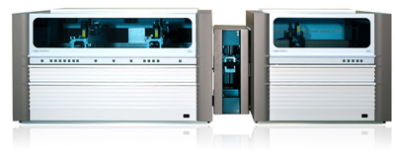
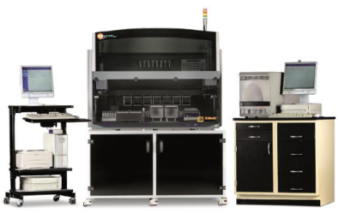
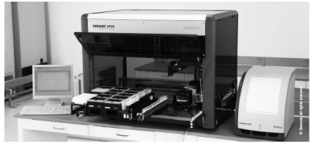
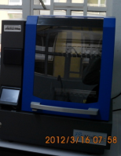
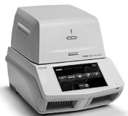
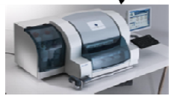
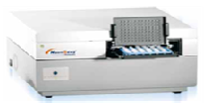
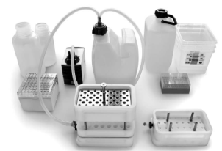
Commercially Available Viral Load Platforms
Roche
Similarities
Well validated
Sophisticated
Designed for plasma
Lab-based
Skilled staff
Abbott
Real-time
PCR
Siemens
NAT
Biocentric
Differences
Technology used
Automation
Throughput
Price
Infrastructure
Compatibility with DBS
Real-time
NASBA
BioMérieux
Non-
NAT
Cavidi
ELISA
Notes:
NAT = Nucleic Acid Amplification Testing.
VL platforms share many similarities in terms of diagnostic performance, however, they differ in terms of type of technology, infrastructure requirements, automation, throughput and cost.

Slide 9
Extraction
The 3 major viral load platforms (Roche, Abbott, and bioMérieux) use the same extraction method:
  During incubation of the lysed samples, all the target nucleic acid is captured by magnetic particles
  A magnetic device attracts all the magnetic particles, enabling the system to purify the nucleic acids through several washing steps
  The heating step releases the nucleic acids from the particles
  At the final step, the magnetic particles are separated from the eluate by the magnetic device

Slide 10
Amplification
bioMérieux System | Real-Time NASBA
Roche Systems | Real-time RT-PCR Technology
Abbott m2000sp and m2000rt System | Real-time RT-PCR Technology

Slide 11
NASBA® Amplification
(bioMérieux System)
Used to amplify RNA only
Primer incorporates T7 promoter and amplifies via T7 RNA polymerase
Uses isothermal conditions, removing time to cycle between temperatures
The NASBA reaction does not give false positives caused by genomic dsDNA, as in the case of RT-PCR
This makes it ideal for DBS testing
Notes:
Initially, amplification causes an exponential rise in the number of amplicons as more RNA copies generated from each RNA target sequence, enter the amplification process. As the reaction progresses the primer pool will become depleted. After primer depletion, the accumulation of RNA transcripts proceeds solely due the transcription of double-stranded DNA, leading to a linear increase in amplicons. It is this phase of the reaction that is used for the determination of transcription products.

Slide 12
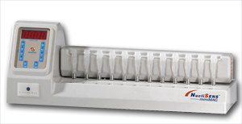
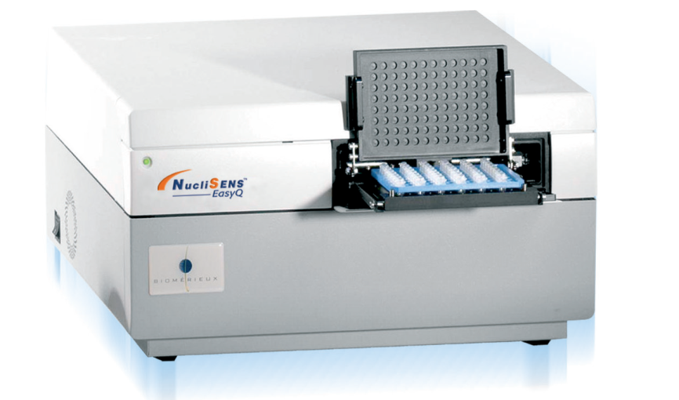
bioMérieux System
NucliSens miniMAG/easyMAG and easyQ
Notes:
The extraction process can be done with a manual version (miniMAG), which is suitable for low-volume testing (12 tests), or a semi-automated system (easyMAG) which is suitable for high-volume testing (24 tests/hour). The amplification process is done with the automated platform (easyQ) using real-time NASBA technology (48 tests/hour). In order to increase throughput two easyMAGs can be combined with one easyQ.

Slide 13
BioMérieux Viral Load Assay
NucliSENS EasyQ HIV-1 V2.0
Type of assay | real-time NASBA Isothermal Signal Amplification
Dynamic Range (copies/mL) | 25 – 10,000,000
Specimen Type | Plasma (EDTA tube) and DBS (CE-marked)
Specimen volume | 100 to 1000μL
Area of HIV genome measured | GAG
HIV-1 subtypes measured | HIV-1 Group M subtypes A-J including CRF
Time for result | Estimated 1 hour (extraction) + 1.5 hours = 2,5 hours
Number of samples/ run (max.) | easyMAG: 24 (22 patient samples + 2 controls)¹ EasyQ: 48 (44 patient samples + 4 controls)
Equipment required – RNA Extraction | miniMAG | easyMAG
Equipment required – Amplification/ Detection | EasyQ
1) Two controls per extraction batch of 24 samples
Notes:
The NucliSENS EasyQ® HIV-1 v2.0 (Automated) has received WHO prequalification for its use with plasma. The DBS method is CE-marked.

Slide 14
Real-time RT-PCR Amplification
(Roche and Abbott)
Reverse Transcriptase (RT) is used to transcribe extracted RNA to cDNA, which is then amplified by PCR.
Detection is done via fluorescent oligonucleotide probes that bind specific target sequences in the HIV-1 RNA genome and a known quantity of quantitation standard (QS) RNA sequence.
The HIV-1 RNA signal is compared with the QS signal which allows for quantitation.
Notes:
The COBAS® AmpliPrep/COBAS® TaqMan® HIV-1 Test, v2.0 has received WHO prequalification for its use with plasma samples.

Slide 15
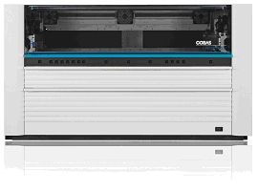
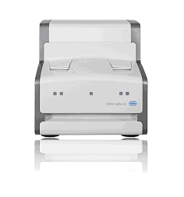
Roche Systems
COBAS® Ampliprep/ COBAS®
TaqMan ® Analyzers
COBAS® Ampliprep/
COBAS®
TaqMan ® 96 Sample Format
COBAS® Ampliprep/ COBAS®
TaqMan ® 48 Analyzer

Slide 16
PCR: Roche Viral Load Assays
COBAS® AmpliPrep/ COBAS® TaqMan® HIV-1
Type of assay | real-time PCR
Dynamic Range (copies/mL) | 20 – 10,000,000
Specimen Type | Plasma (EDTA tube) and DBS (RUO)
Specimen volume | 1000 to 1050 μL (plasma) and one 70 μL spot (DBS)
Area of HIV genome measured | GAG, LTR
HIV-1 subtypes measured | HIV-1 Group M subtypes A-H, Group O, including CRF
Time for result (per run) | Estimated 2,5 hours + 3 hours = 5,5 hours
Number of samples/ run (max.) | TaqMan 48: 48 (42 patient samples + 6 controls)^{(1,2)} TaqMan 96: 96 (84 patient samples + 12 controls)^{(1,2)}
Equipment required – RNA Extraction | COBAS® AmpliPrep System
Equipment required – Amplification/ Detection | COBAS® TaqMan 48® Analyzer OR | COBAS® TaqMan 96® Analyzer
Three controls per run of up to 24 each (21 patient sample + 3 controls)
2 or 4 independent (respectively) 24-well thermocyclers
Notes:
The COBAS® AmpliPrep/COBAS® TaqMan® HIV-1 Test, v2.0 is the latest version and has received WHO prequalification for its use with plasma samples. The use of DBS remains for Research use only (RUO).

Slide 17
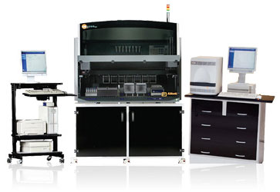
Abbott
M2000sp and m2000rt System
m2000rt
m2000sp

Slide 18
PCR: Abbott Viral Load Assay
RealTime HIV-1
Type of assay | real-time PCR
Dynamic Range (copies/mL) | 40 – 10,000,000
Specimen Type | Plasma (EDTA tube) and DBS (RUO)
Specimen volume | 200 to 1000 μL (plasma) and one 70 μL spot (DBS)
Area of HIV genome measured | POL Integrase
HIV-1 subtypes measured | HIV-1 Group M subtypes A-H, Group O, Group N, including CRF
Time for result | Estimated 5 hours (extraction) + 2.5 hours (amplification) = 7.5 hours
Number of samples/run (max.) | m24sp: 24 (21 patient samples + 3 controls) ⁽¹⁾ m2000sp: 96 (93 patient samples + 3 controls)⁽¹⁾
Equipment required – RNA Extraction | m2000sp or | m24sp
Equipment required – Amplification/Detection | m2000rt
1) Three controls per batch or 96 deep well plate (21 or 93 patient sample + 3 controls)

Slide 19
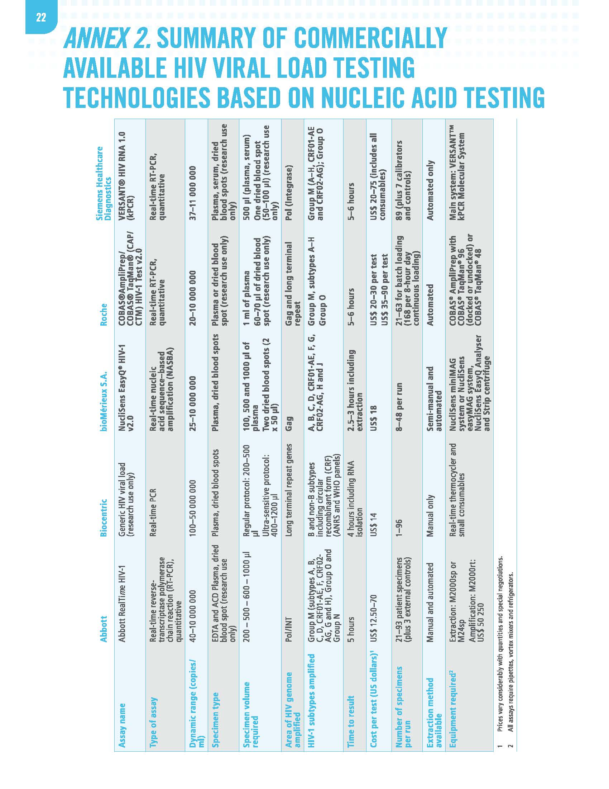
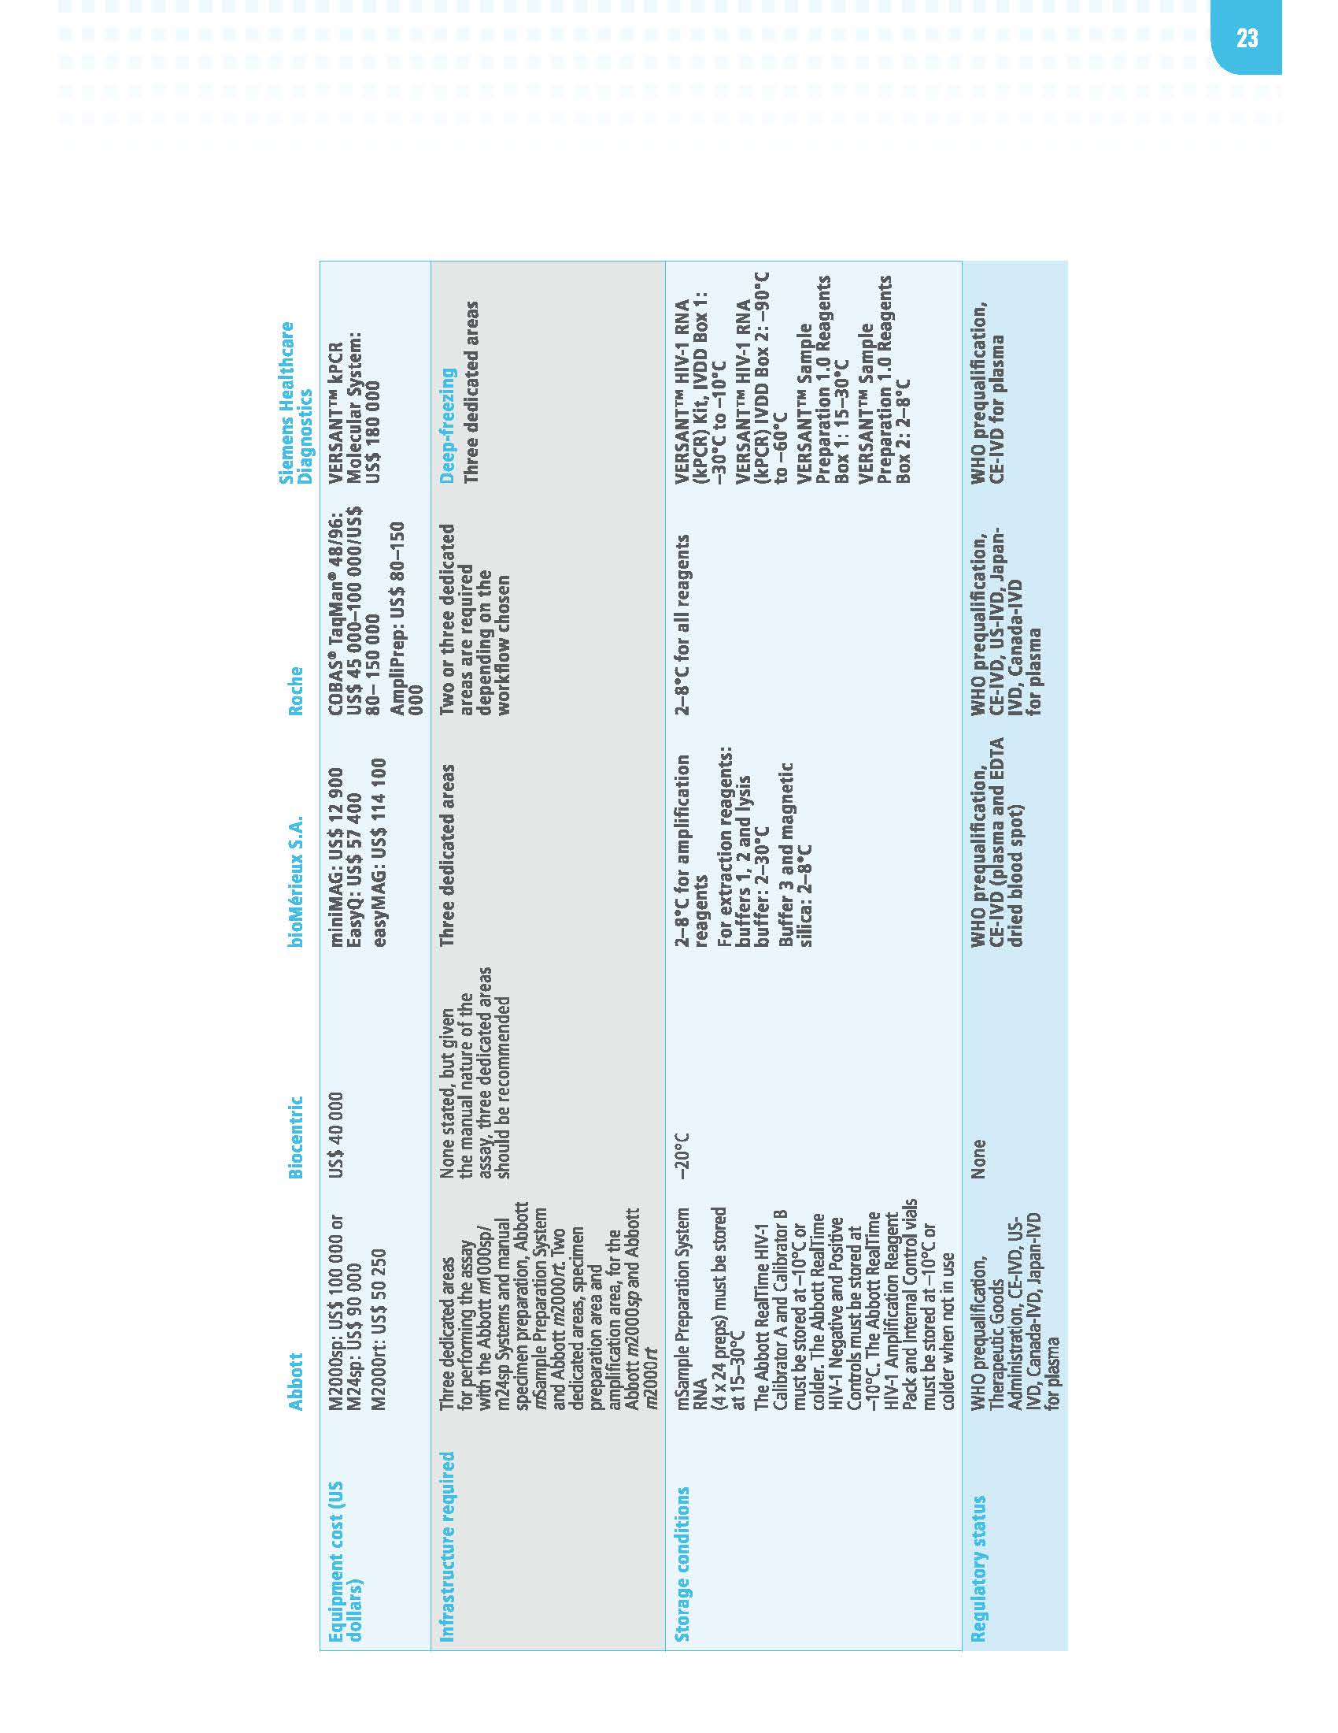

Summary of Commercially Available Platforms
Handout
4-1
From WHO Technical and Operational Considerations for Implementing HIV Viral Load Testing, July 2014.

Slide 20
Selecting Viral Load Technologies for your Setting
What should a country consider, besides costs, when selecting the viral load technologies and platforms?
The selection of viral load technologies should not rely solely on the technical specification and characteristics of a viral load platform
Consider specimen types and operational considerations:
    Efficiency of specimen transport system
    Expected testing volumes
    Human resources
    Technical support.

Slide 21
Knowledge Check
What is the molecular technique used for viral load testing by both Roche and Abbott? Select the most appropriate answer from below.
  NAT technology
  NASBA® Amplification
  Real-time RT-PCR
  bDNA
A
B
C
A and C
All
√

Slide 22
Knowledge Check
What is the molecular technique used by NucliSens? Select the best answer.
  NASBA® Amplification
  bDNA
  Real-time RT-PCR
  All of the above
√

Slide 23
viral load testing infrastructure and workflow

Slide 24
Viral Load Testing Laboratory Infrastructure
2 – 3 dedicated rooms with minimal dust, preferably with temperature control (air-conditioner)
Sample Prep and extraction Room
  Sample prep extraction should be done preferably in a Biosafety Cabinet
MasterMix Room (can be reduced to a Clean-Air Box in ROOM 1 if space is limited)
  Master-Mix Preparation
  Only required if using a manual or semi-automated test method
Amplification and Detection Room (becomes highly contaminated and should be separate from ROOMS 1 and 2 in case of separate amplification and detection)
  PCR Amplification and Detection
  Results validation and documentation
To avoid contamination workflow in the laboratory MUST proceed in a unidirectional manner.
Sample Prep and extraction Room
MasterMix Room
Amplification and Detection Room
Notes:
Useful WHO reference: Establishment of PCR laboratory in developing countries http://apps.searo.who.int/PDS_DOCS/B4745.pdf
PCR has a strong susceptibility to contamination, therefore, the most critical aspect in working in a PCR laboratory is to follow a unidirectional work flow. Wear different lab coats for each room. Never go back from Room 3 to Room 2 or 1 without changing coats.

Slide 25
Viral Load Testing Laboratory
Physical Set-up
bench space: Each room should have 3 – 4 meters bench space.
Storage: Reagent kits should be stored according to manufacture specified temperatures
Electricity:
  Steady current and dedicated power
  Uninterruptible power supply (UPS)
Biohazard waste disposal facilities: biohazard bags, bins, autoclave and incinerator
Notes:
Useful WHO reference: Establishment of PCR laboratory in developing countries http://apps.searo.who.int/PDS_DOCS/B4745.pdf

Slide 26
Suggested Laboratory Layout
Sample Extraction and Master-Mix Prep. Rooms (1 & 2)
Fridge/freezer
(Reagent Storage)
Freezer
(Sample Storage)
Bench for Centrifuge
80 cm
80 cm
90 cm
70 cm
Sample Prep and Extraction
(preferably in a BSC)
Sample Prep and Extraction Area
(ROOM 1)
200 cm
Manual or Automated Extraction Instrument
Master-Mix Preparation Area (ROOM 2)
Bench area
Closed Air
Box
This “clean area” can be a separate room or can consist of a “Closed Air Box” in one corner of the Sample Prep/Extraction Room (ROOM 1)
Notes:
Use negative pressure in the Sample Extraction Area (Room 1) to keep template nucleic acids in the room.
Use positive pressure in the Master-Mix Preparation Area (Room 2) to prevent the introduction of contamination.
Educational video: https://www.youtube.com/watch?v=V2JYy6-DE9c

Slide 27
PCR: Suggested Laboratory Layout
Sample Amplification and Detection Room (3)
Amplification/ detection instrument
100 cm
Printer
Result validation and documentationarea
200 cm
200 cm
Amplification and Detection Area
(ROOM 3)
Notes:
The thermocycler /real-time PCR machine should be kept in this room. Gloves and laboratory coats should be worn at all times and removed before leaving the room to control amplicon contamination of other locations. All equipment used for amplification and product detection should be dedicated to this room, including adjustable pipettes with plugged, aerosol-barrier tips. This room should be kept under negative pressure to keep amplified nucleic acids in the room.

Slide 28
Maximizing your Viral Load Testing Throughput
Scenario | Maximum Throughput | Your current level?
One Roche 96 machine, 8-hour shift, 2 people | 110 specimens
One Roche 96 machine, 12-hour shift, 2 people | 150 specimens
One Roche 96 machine, 24-hour shift, 2 people | 270 specimens
One Abbott m2000 machine, 8-hour shift, 2 people | 111 specimens
One Abbott m2000machine, 12-hour shift, 2 people | 180 specimens
One Abbott m2000machine, 24-hour shift, 2 people | 270 specimens
Brainstorm ways your can improve your throughput:
Are these number realistic to you?
What is the best way to achieve or even go beyond these numbers?

Slide 29
Tips for Maximizing Workflow Efficiency
Use free downloadable app to generate barcodes for specimens’ lab ID to minimize transcription errors and data entry time
Use appropriate pipettes (2 ml instead of 1 ml) when transferring 1.1 ml plasma into the reaction tubes to save time and to avoid cross-contamination
Vortex plasma inside the BSC to minimize specimen travel
Use the same type of DBS cards to simplify procurement and training
Use perforated DBS cards instead non-perforated cards. Use disposable plastic pipettes to punch out the circles (instead of scissors)
Assign dedicated personnel to alert clinics of high viral load results on a daily basis
Minimize instrument down time between procedures using teams working in a manufacture assembly-line fashion.

Slide 30
Knowledge Check
How should viral load testing work flow proceed? Select the best answer.
  From Extraction room to Master mix room to Amplification room
  From Master mix room to Extraction room to Amplification room
  From Amplification room to Extraction room to Master mix room
√

Slide 31
Sample receipt, rejection, check-in and storage until testing

Slide 32

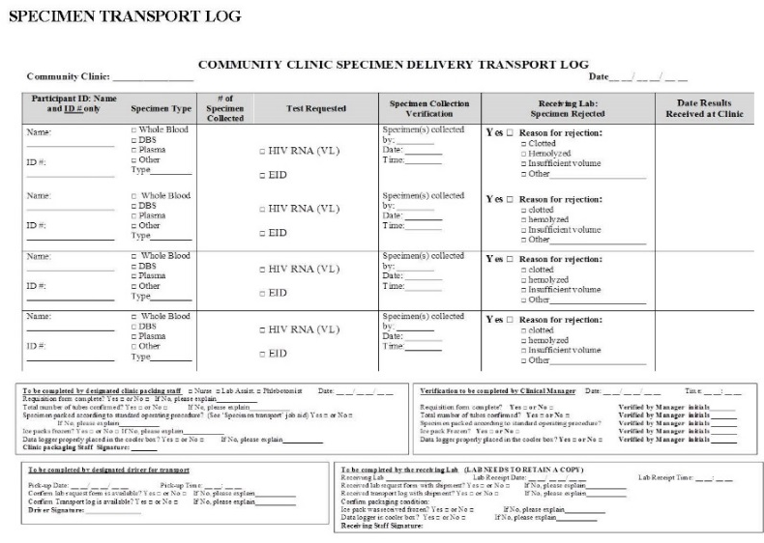
Handout
4-2
3-10

Slide 33
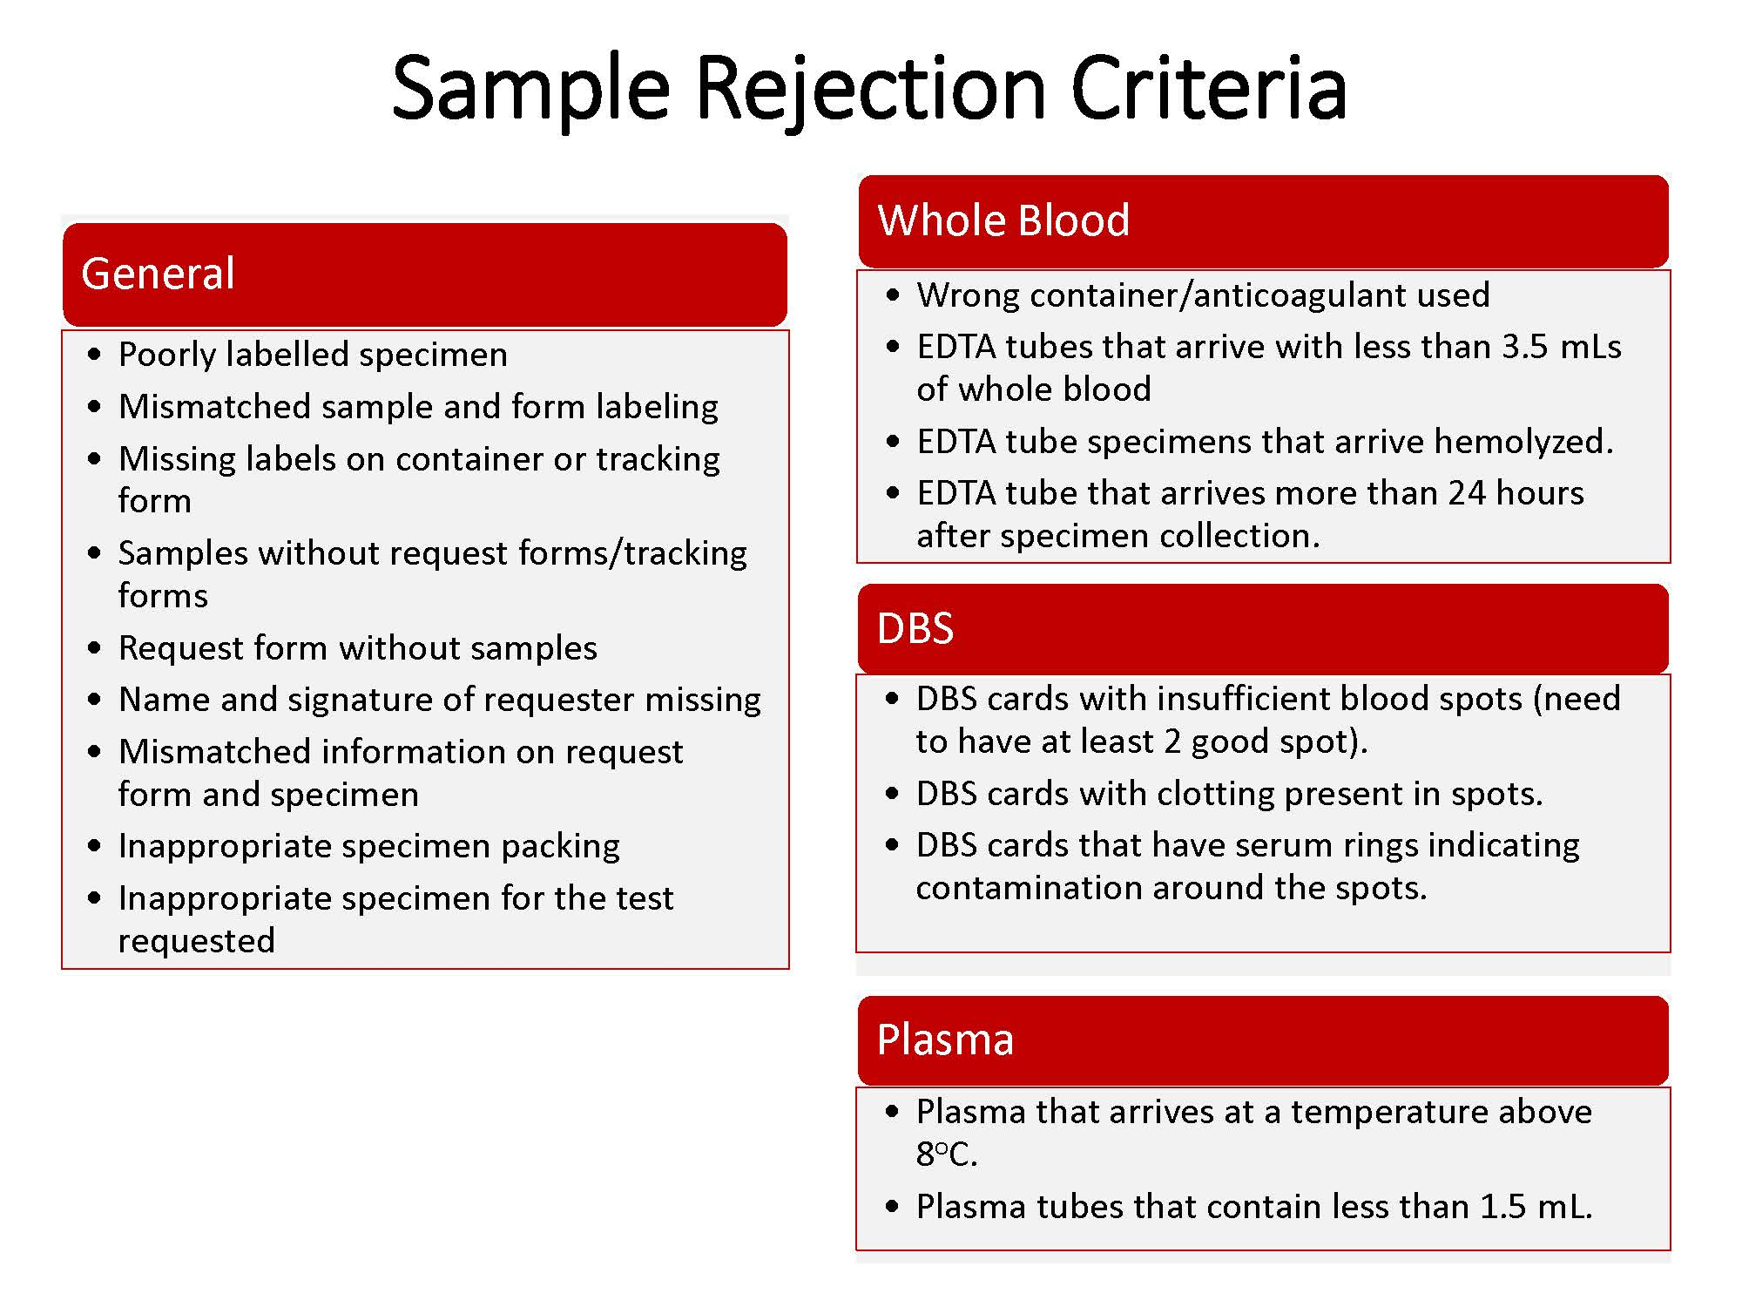
Handout
3-11

Slide 34
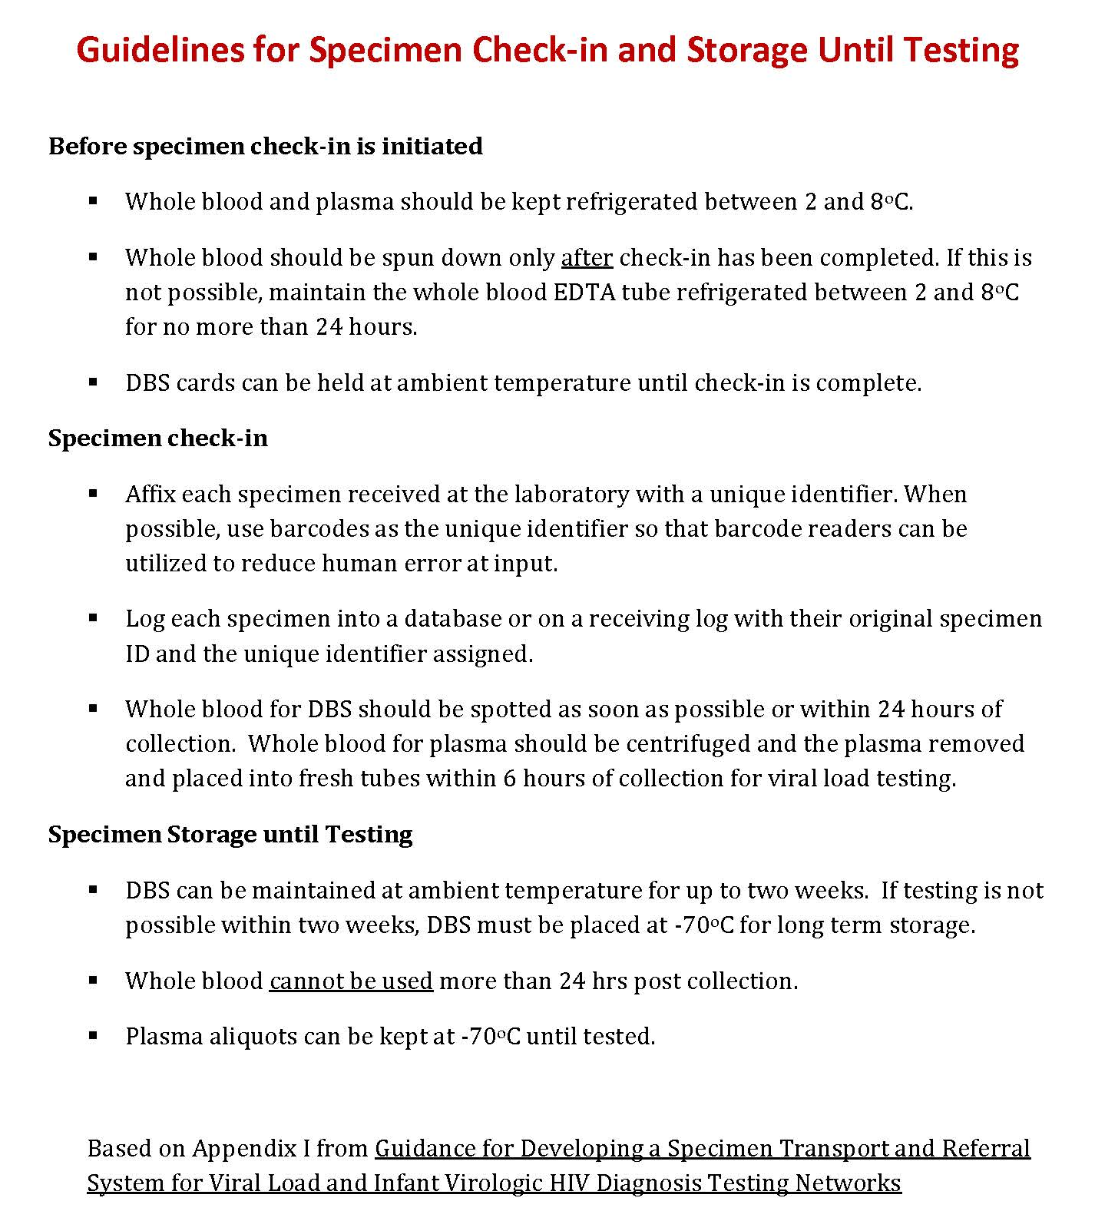
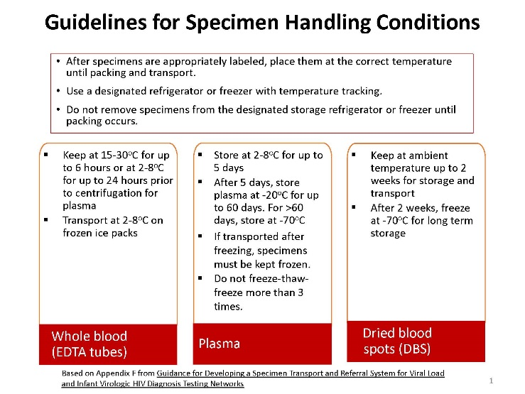
Handout
4-3
3-5

Slide 35
Preventing and Troubleshooting Problems

Slide 36
Common Errors – How to Prevent them?
Errors may be caused by:
Improperly thawed/mixed/ dissolved reagent
Air bubbles in reagents and reagent lines
Sampling or reagent syringe problems
Pipette tips not fitting properly
A clogged pipette
Imprecise pipette
Unstable temperature and incubation
Variations in operator technique
Incorrect reconstitution of the control product
To minimize errors:
Strictly follow the SOP
Always perform instrument and laboratory equipment maintenance and calibrations
Ensure a consistent and appropriate testing environment
Ensure the competency of the testing personnel
Notes:
Random errors are caused by unknown and unpredictable changes during testing.
These changes may occur in the measuring instruments or in the environmental conditions. Because random errors are unpredictable, singular events, they can be difficult or even impossible to detect. Random errors should only be considered if ALL alternative sources of error have been investigated.
Although random errors can be extremely hard to detect retrospectively, they can be avoided by preventative action and consideration of certain factors. During all testing events, be aware of and avoid the following:
This list is non-comprehensive. Random errors can occur at any moment during testing. Take every precaution to maintain consistency at every moment during testing.
To prevent random errors, avoid variation between testing events, always perform instrument and laboratory equipment maintenance and calibrations, and guarantee a consistent and appropriate testing
environment.

Slide 37
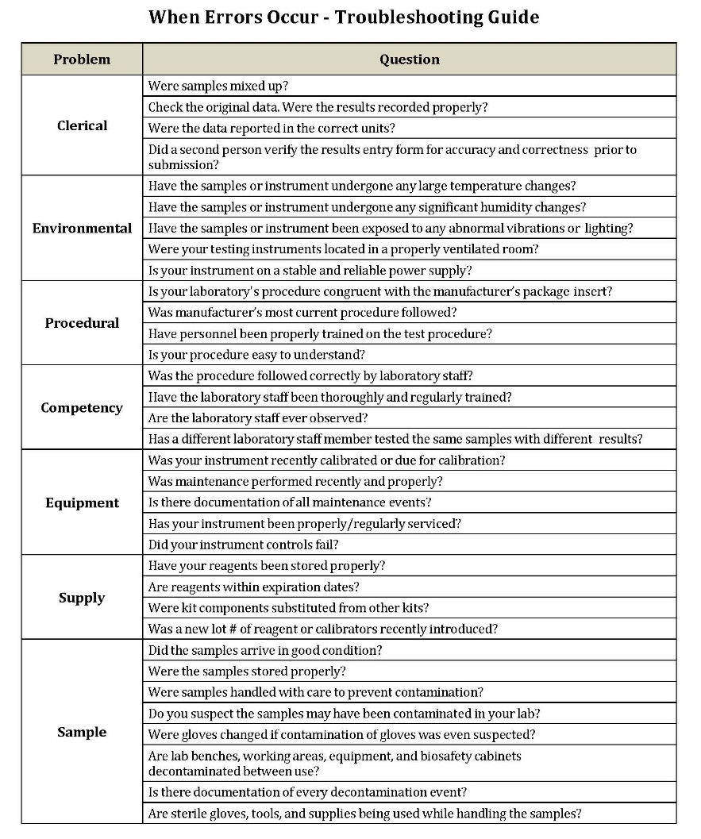
Handout
4-4

Slide 38
Activity 4A: Troubleshooting and Corrective Action
Purpose
To develop corrective action for each category of problem encountered during viral load testing.
What will you need?
Flipchart paper
Handout 4-4: When Errors Occur - Troubleshooting Guide
What will you do?
Divide into 7 groups - each group will be assigned one category of problem in the Troubleshooting Guide.
  Review your category of problem in the troubleshooting guide and discuss within your group the corrective action needed to address the problem
  Write your suggestions on a flipchart
  Select a spokesperson to present your corrective actions ( 2 minutes).
  Participate in large-group discussion
Handout
10 minutes
4-4
Notes:
38

Slide 39
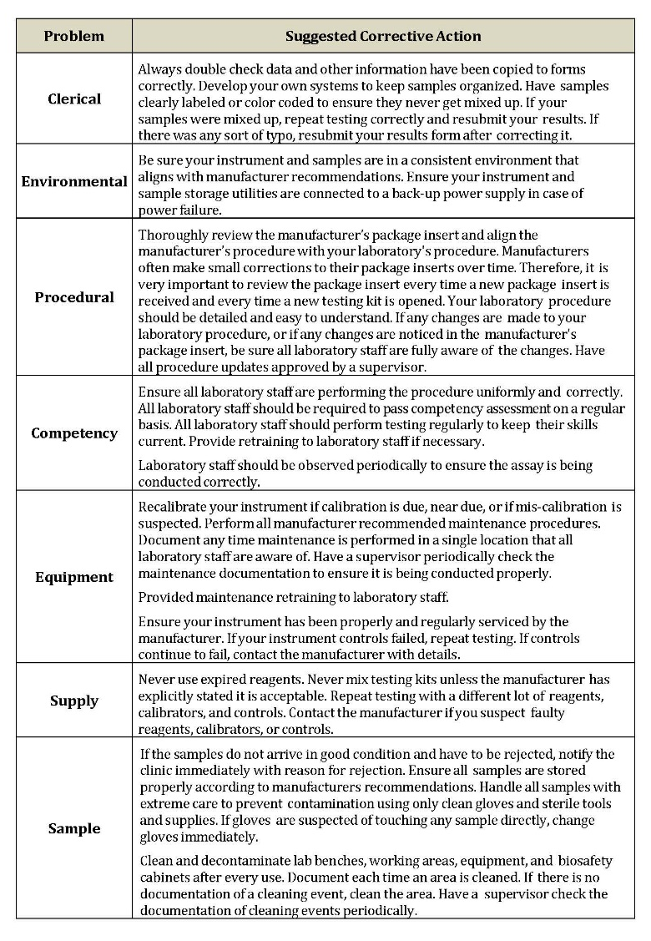
Activity 4A: Suggested Corrective Action
Handout
4-5

Slide 40
Ensuring the quality of the testing phase

Slide 41
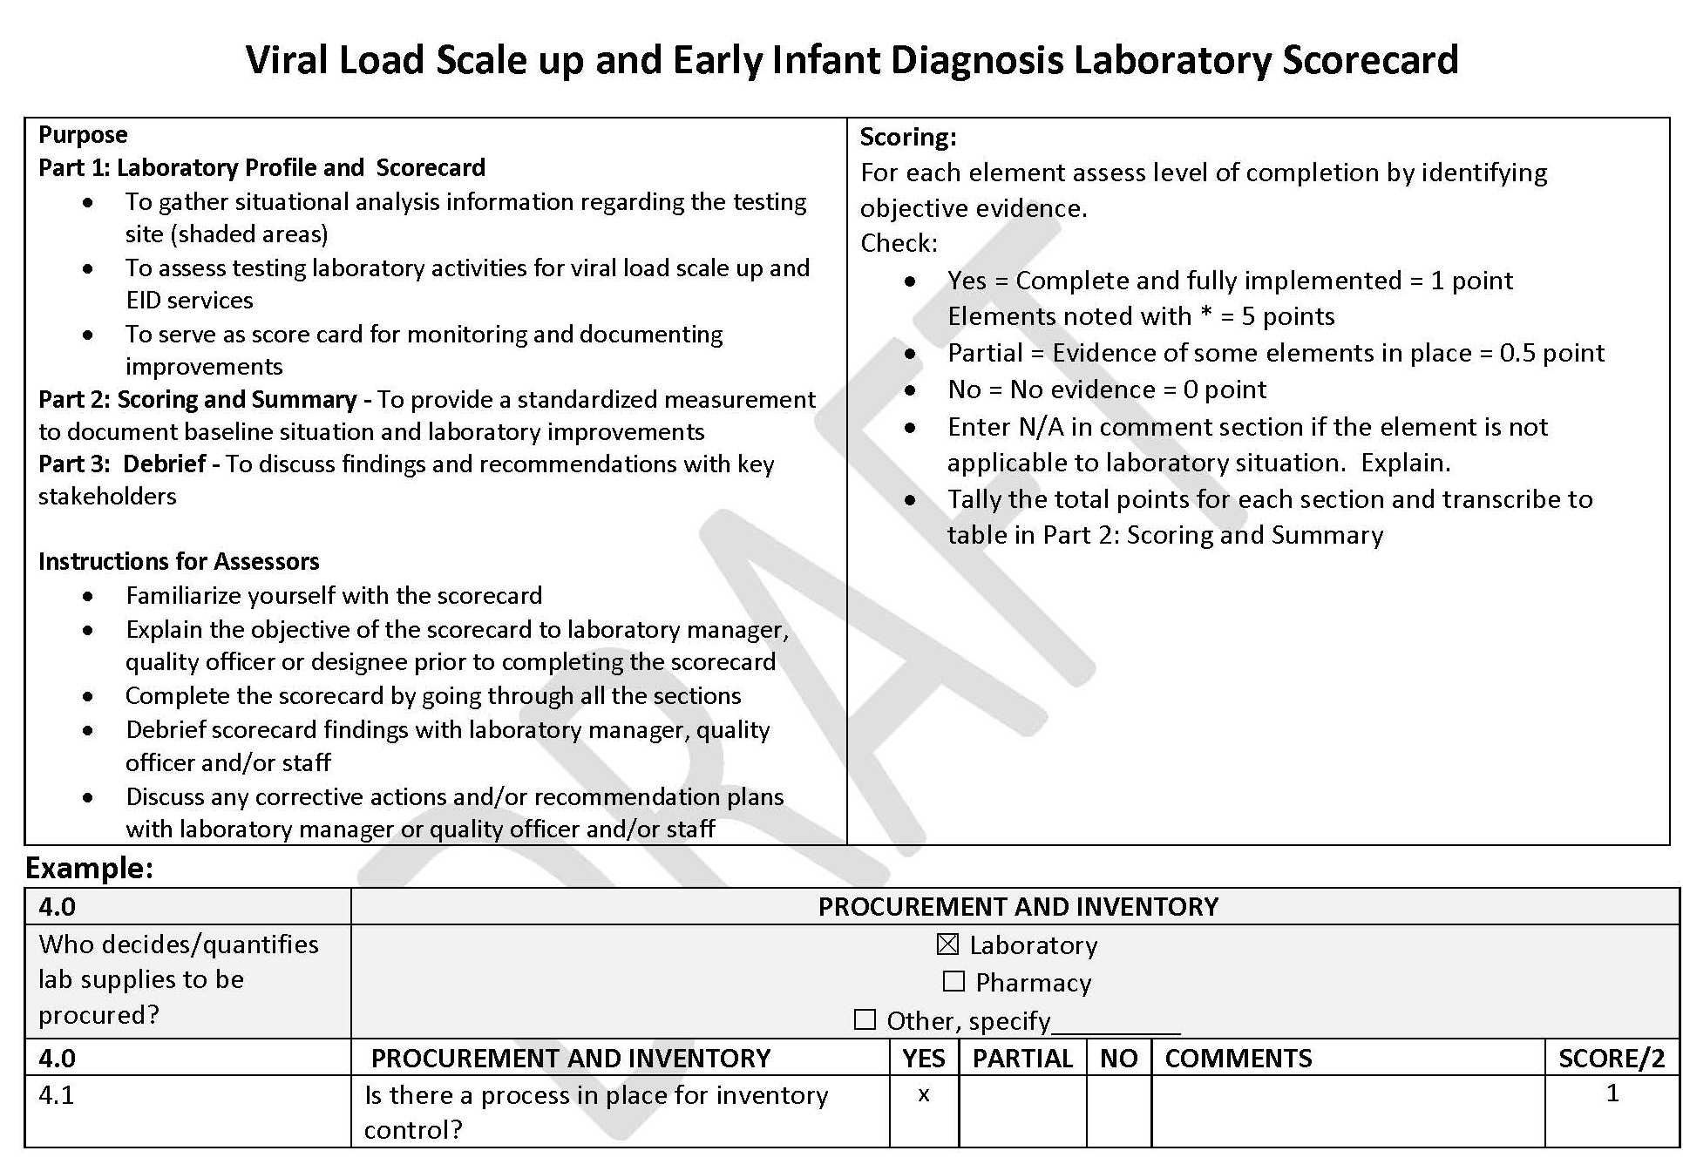
Viral Load Laboratory Readiness Assessment Checklist
Handout
4-6

Slide 42
Quality Indicators
Number of specimens rejected (by reason, by clinic)
Turn around time from specimen collection to specimen arrival at lab
Turn around time from specimen arrival to testing
Turn around time from testing to result return to clinic
Number of specimens tested
Number of invalid results (per week or month)
Number of Target Not Detected (TND)
Number of high viral load results (>1000 copies/ml)
Number of runs out of QC range
Number of days testing is halted (per month) due to instrument breakdown
Number of days testing is halted (per month) due to out-of-stock
Backlog – both number of specimens and length of time in storage

Slide 43
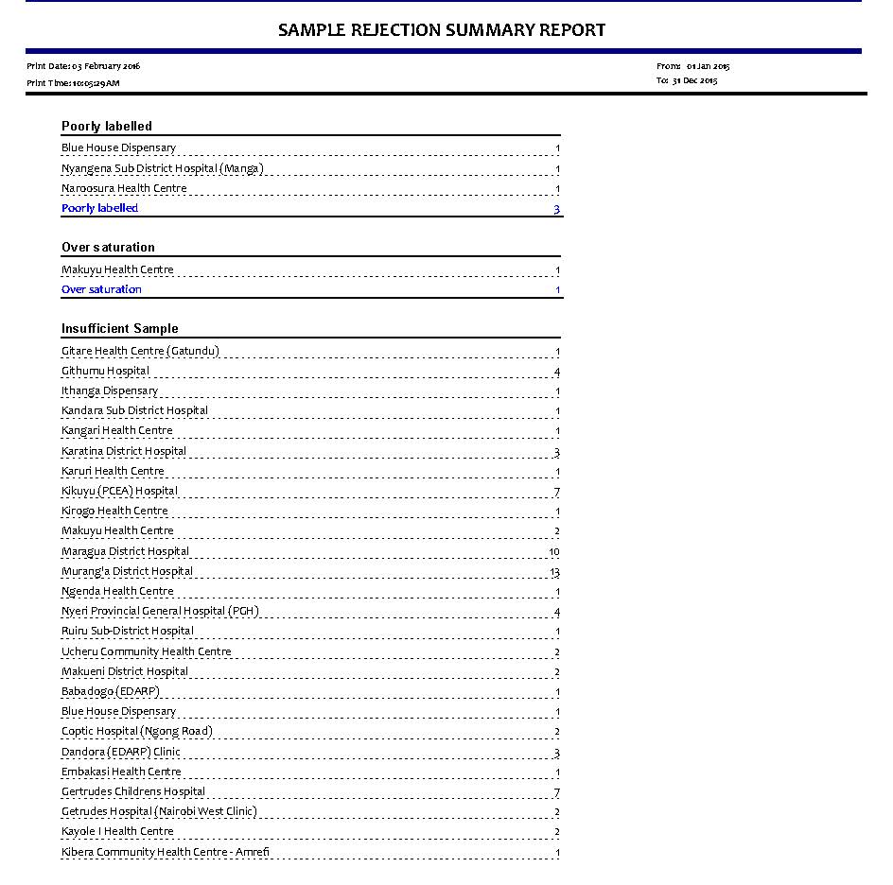
Tracking Sample Rejection by Criteria and by Clinic Pinpoints the Source of the Problem
Reason for Rejection
Frequency of occurrences
Site name

Slide 44
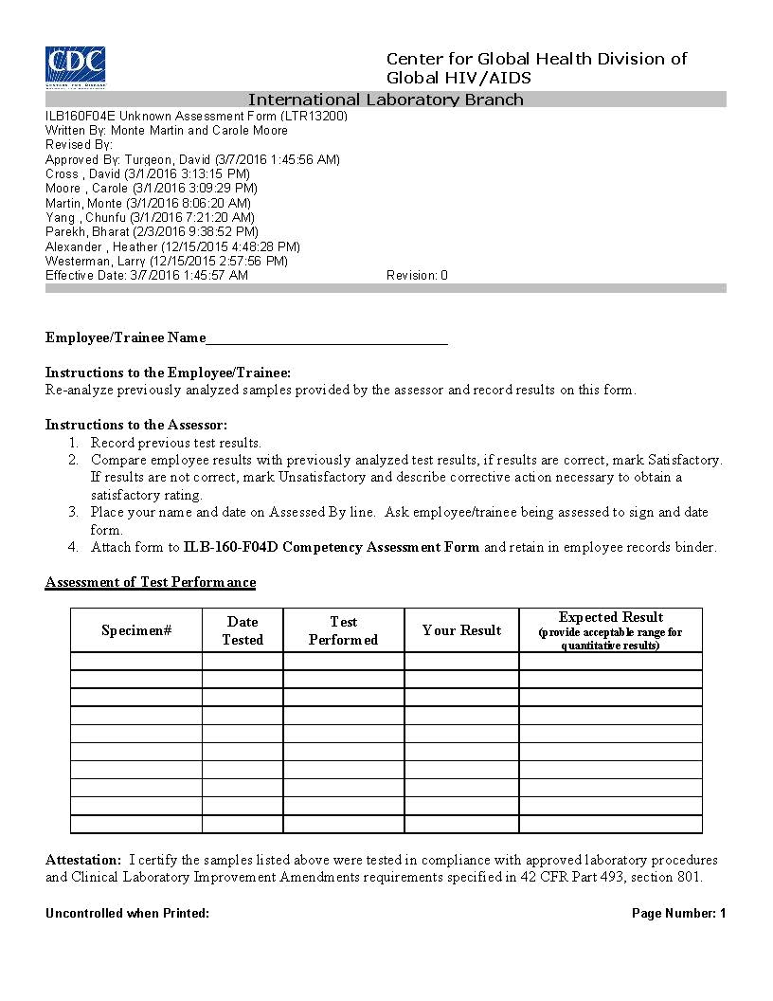
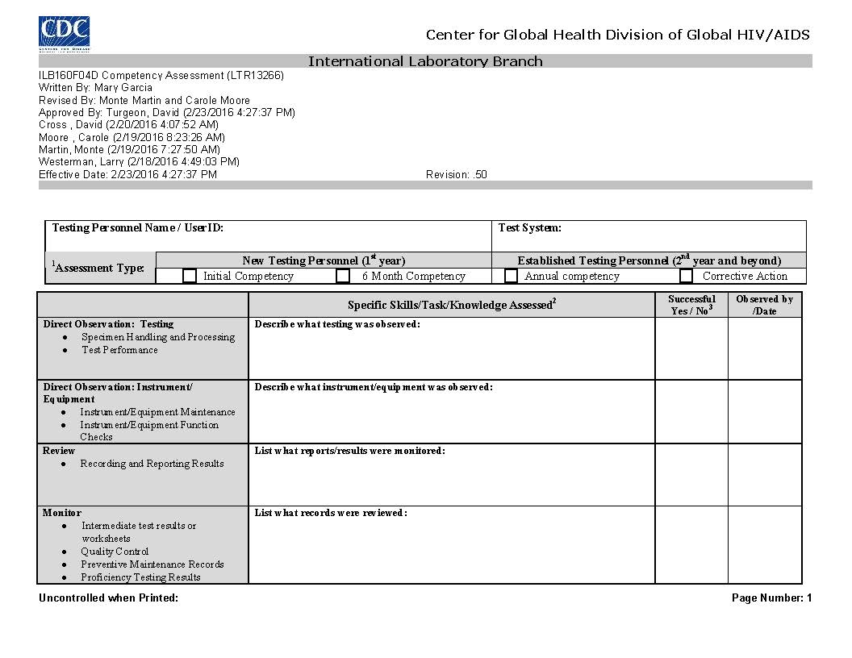
Ensuring the Competency of Testing Personnel
Test operators must be trained
Their competency must be assessed at least once a year
Handout
4-7

Slide 45
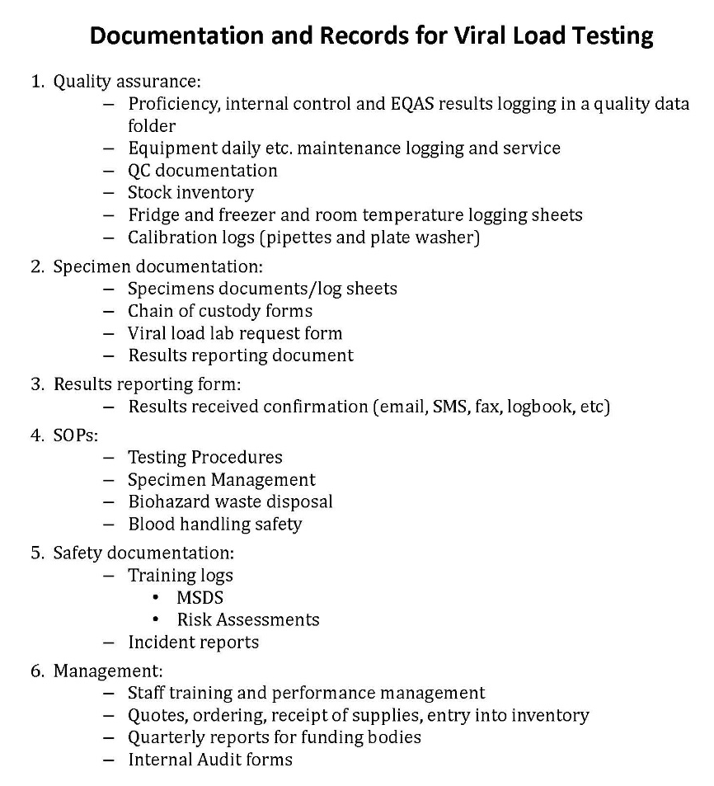
Documentation and Records for Viral Load Testing
Handout
4-8

Slide 46
Result recording and reporting

Slide 47

Guidelines for Result Reporting (1)
Handout
4-9

Slide 48
Guidelines for Result Reporting (2)
Results generated
Data clerk at lab reviews all approved results
<1000 copies/ml
≥1000 copies/ml
  Record sample #, ART #, DOB, date of result and value, and facility name
  Data clerk prints the reports
  Email or call the POC at clinic with the information for entry into daily log book and high VL register
  Deliver results via email, SMS, fax, courier, etc.
  Verify receipt
  Verify results receipt at clinic
Handout
  Retain results in secure area
4-9

Slide 49
Key Messages
The selection of viral load technologies should not rely solely on the technical specification and characteristics of a viral load platform, but also specimen types and operational considerations, such as _________________, _______________, _______________, and technical support.
Although new viral load technologies are highly automated and sophisticated, strict adherence to ____, regular ___________, and _______________are crucial in guaranteeing accurate and reliable results.
Proper _____________, ____________, and _________ are critical aspects of a viral load laboratory in order to reduce the risk of contamination.
Testing personnel’s competency should be assessed at least _____________.

Slide 50
Key Messages
The selection of viral load technologies should not rely solely on the technical specification and characteristics of a viral load platform, but also specimen types and operational considerations, such as efficiency of specimen transport system, expected testing volumes, human resources and technical support.
Although new viral load technologies are highly automated and sophisticated, strict adherence to SOPs, regular equipment maintenance, and personnel competency are crucial in guaranteeing accurate and reliable results.
Proper infrastructure, physical layout, and workflow are critical aspects of a viral load laboratory in order to reduce the risk of contamination.
Testing personnel’s competency should be assessed at least once a year.

