Slide 1
Module 2:
Implementing the Viral Load Algorithm
DRAFT
Suitable for all cadres: Clinicians, Counsellors, and Laboratorians

Slide 2


Module 2: Objectives
Follow the national algorithm
  Determine when a viral load test should be ordered
  Interpret results of viral load and switch patients to a second line ARV regimen appropriately
Identify clinic-based strategies to improve implementation at each step of the algorithm

Slide 3
Knowledge Check
True of False:
    When Viral Load is “undetectable,” it means the patient is no longer HIV-positive.
WHO’s definition of successful ART is a viral load value <______ copies/ml (or <____Log₁₀)
    FALSE
1,000
3

Slide 4
Accurately following a national algorithm

Slide 5

Three Scenarios for Viral Load Results
Virus is NOT suppressed:
  Current ART working but patient is not taking it properly, OR
  ART is not working due to resistance or treatment failure
Viral Load > 1,000 copies/ml
1,000 copies/ml
Viral Load ≤ 1,000 copies/ml
Virus is suppressed
ART is working
Continue current regimen
Does not mean HIV has disappeared
HIV is still present in reservoirs
Continue current regimen
Handout
Undetectable
2-1

Slide 6

National Viral Load Algorithm
Targeted viral load monitoring (Suspected clinical or immunological failure)
Routine viral load monitoring (Early detection of virological failure)
Test viral load
Viral load > 1000 copies/ml
Evaluate for adherence concerns
Repeat viral load testing after 3-6 months
Viral load ≤ 1000 copies/ml
Viral load > 1000 copies/ml
Handout
Maintain first-line therapy
Switch to second-line therapy
2-2

Slide 7
Applying the National Viral Load Algorithm
Scenario 1 - A 36 year old male patient had his first viral load test performed after 6 months on ART. The result was <1,000 copies/ml. Six months later repeat Viral Load test was also <1,000 copies/ml. What should be the next steps? When should the next Viral Load test be performed? Select the appropriate cut-outs and map out the scenario.
<1,000 copies/ml
<1,000 copies/ml
>1,000 copies/ml
>1,000 copies/ml
Switch to 2nd line
VL
VL
VL
Maintain current regimen
Initiation
of ART
M1 M2 M3 M4 M5 M6 M7 M8 M9 M10 M11 M12
M1 M2 M3 M4 M5 M6 M7 M8 M9 M10 M11 M12
M1 M2 M3 M4 M5 M6 M7 M8 M9 M10 M11 M12

Slide 8
Applying the National Viral Load Algorithm
Scenario 2 - A 30 year old female patient had her first viral load test performed after 6 months on ART. The result was 5,000 copies/ml. What should be the next steps? Assuming another Viral Load test was ordered according to the national algorithm and the result was <1,000 copies/ml, what should be the next steps? When should the next Viral Load test be? Select the appropriate cut-outs and map the scenario.
Maintain current regimen
Switch to 2nd line
Adherence Counseling
<1,000 copies/ml
<1,000 copies/ml
>1,000 copies/ml
>1,000 copies/ml
VL
VL
VL
VL
Initiation of ART
M1 M2 M3 M4 M5 M6 M7 M8 M9 M10 M11 M12
M1 M2 M3 M4 M5 M6 M7 M8 M9 M10 M11 M12
M1 M2 M3 M4 M5 M6 M7 M8 M9 M10 M11 M12

Slide 9
Activity 2A: Applying the National Viral Load Algorithm
Purpose
Practice different scenarios using the national viral load algorithm in
What will you need?
Activity 2A Scenario Sheet
Cut-outs for each scenario
Scissors, yellow tape for timeline, and scotch tape/glue
What will you do?
Divide into 3 groups – scenario A, B, or C.
  Review the scenario and discuss within your group.
  Select the appropriate cut-outs and map out the scenario on the wall or a piece of flipchart paper.
  Participate in large-group discussion.
Handout
2-3, 2-4
15 minutes

Slide 10
Applying the National Viral Load Algorithm
Scenario A - A 25 year old female patient had her first viral load test performed after 6 months on ART. The result was <1,000 copies/ml. What should be the next steps? Assuming another Viral Load test was done according to the national algorithm and the result was 10,000 copies/ml, what should be the next steps? Assuming the next Viral Load test result was 5,000 copies/ml, what should be the next steps? When should the next Viral Load test be? Select the appropriate cut-outs and map the scenario.
Maintain current regimen
Switch to 2nd line
Adherence Counseling
<1,000 copies/ml
<1,000 copies/ml
>1,000 copies/ml
>1,000 copies/ml
VL
VL
VL
VL
Initiation of ART
M1 M2 M3 M4 M5 M6 M7 M8 M9 M10 M11 M12
M1 M2 M3 M4 M5 M6 M7 M8 M9 M10 M11 M12
M1 M2 M3 M4 M5 M6 M7 M8 M9 M10 M11 M12

Slide 11
Applying the National Viral Load Algorithm
Scenario B - A 45 year old male patient had his first viral load test performed after 6 months on ART. The result was <1,000 copies/ml. What should be the next steps? Assuming another Viral Load test was ordered according to the national algorithm and the result was 7,500 copies/ml. what should be the next steps? Another Viral Load test was done and the result was <1,000 copies/ml. What should be the next steps? When should the next Viral Load test be performed? Select the appropriate cut-outs and map the scenario.
Maintain current regimen
Switch to 2nd line
Adherence Counseling
<1,000 copies/ml
<1,000 copies/ml
>1,000 copies/ml
>1,000 copies/ml
VL
VL
VL
VL
Initiation of ART
M1 M2 M3 M4 M5 M6 M7 M8 M9 M10 M11 M12
M1 M2 M3 M4 M5 M6 M7 M8 M9 M10 M11 M12
M1 M2 M3 M4 M5 M6 M7 M8 M9 M10 M11 M12

Slide 12
Applying the National Viral Load Algorithm
Scenario C - A 15 year old female patient had her first viral load test performed after 6 months on ART. The result was 150,000 copies/ml. What should be the next steps? Assuming another Viral Load test was ordered according to the national algorithm and the result was 10,000 copies/ml. what should be the next steps? When should the next Viral Load test be? Select the appropriate cut-outs and map the scenario.
Maintain current regimen
Switch to 2nd line
Adherence Counseling
<1,000 copies/ml
<1,000 copies/ml
>1,000 copies/ml
>1,000 copies/ml
VL
VL
VL
VL
Initiation of ART
M1 M2 M3 M4 M5 M6 M7 M8 M9 M10 M11 M12
M1 M2 M3 M4 M5 M6 M7 M8 M9 M10 M11 M12
M1 M2 M3 M4 M5 M6 M7 M8 M9 M10 M11 M12

Slide 13
Choosing the appropriate course of action given a patient’s viral load result

Slide 14
All viral loads > 1,000 copies/ml need further investigation
Discuss: Which of these is the MOST COMMON?
Poor Adherence: current ARV regimen could still work, but the patient is not taking it properly
Resistance or Treatment Failure: current ARV regimen is no longer working

Slide 15
Reasons for Viral Load >1,000 copies/mL
Discuss: What are possible reasons for Resistance or Treatment Failure?
  Drug interactions causing sub-therapeutic levels of ARVs e.g., rifampicin, traditional medicines, anti-epileptics (any enzyme-inducing drug)
  GI intolerance leading to sub-therapeutic levels of ARVs (i.e., chronic diarrhoea or vomiting)
  Side effects—patient, therefore, not taking their drugs as prescribed
  Previous exposure to ART (including PMTCT) resulting in pre-existing resistance
  Not changing the ART dose according to weight change in pediatric patients

Slide 16
Reasons for Viral Load >1,000 copies/mL
Discuss: What are some Common Challenges leading to Poor Adherence?
  Economic barriers for accessing care
  Alcohol or drug abuse
  Feeling better, so they think they don’t need ART
  Pregnancy and breastfeeding mothers possible at high risk of poor adherence
  Changing guardian for pediatric ART care
  Side-effects causing patients to stop their medication
  Social instability (e.i., homelessness, migratory populations, etc.)

Slide 17
All Viral loads > 1,000 copies/ml require action
  Discuss: What action should be taken by the:
  Clinic?
    Flag patient’s record
    Follow-up with patient if missed adherence counseling or viral load testing
  Clinician?
    Explore medical reasons impacting the patient’s adherence and counsel patient as needed
    Complete appropriate documentation
    Advise the patient on when to return for repeat viral load testing according to algorithm

Slide 18
All Viral loads > 1,000 copies/ml require action
  Discuss: What action should be taken by the:
  Counsellor?
    Explore possible psychosocial factors impacting the patient’s adherence
    Complete adherence counseling sessions with the patient
  Patient?
    Attend adherence counseling sessions
    Repeat viral load testing 3-6 months later
    Take antiretroviral medication daily

Slide 19
Why is Adherence so Important?
You cannot say the drugs have failed unless you have used them in the correct dose and for the right amount of time
3 drugs
Correct dosage:
≤ 3 mistakes/month
3-6 months
Adherence Rule of 3s

Slide 20
Why is Adherence Counseling so Important?
By counseling the patient on adherence, we have been able to:
  Improve the adherence of the patient
  Improve the treatment outcome
    Between 54-89% of patients will re-suppress*
  Prevent the development of resistance and keep the first line treatment regimen
*Bonner, Kimberly, Alyssa Mezochow, Teri Roberts, Nathan Ford, and Jennifer Cohn. "Viral Load Monitoring as a Tool to Reinforce Adherence." JAIDS Journal of Acquired Immune Deficiency Syndromes: 74-78.

Slide 21
When to Take the Repeat Viral Load
Take the repeat viral load 3-6 months after the first viral load result is discussed and first adherence counselling session is completed
If patient is clearly non-adherent, delay taking the repeat viral load until adherence issues have been addressed

Slide 22
If the Repeat Viral Load Result is
< 1,000 copies/ml
Congratulate the patient and:
Explain the result of the second viral load to the patient
  Explain that the virus is still present in the body and is being suppressed by the current treatment
Continue first line treatment
Return to routine schedule of viral load monitoring per algorithm
Handout
2-2

Slide 23

If the Repeat Viral Load Result is
> 1,000 copies/ml
Before the patient comes in for their appointment:
Review and discuss the case in a team meeting
If adherence issues were resolved:
  Assume likelihood of resistance and switch the patient to a second line regimen
If adherence issues remain:
  Review case to assess if switch can be delayed and viral load repeated in 3 months
Handout
2-2

Slide 24
Viral Load >1,000 copies/ml means Treatment Failure when…
Viral load > 1000 copies/ml
2 consecutive times
3 months apart
With good adherence in between
Regimen failure or treatment failure indicates possible drug resistance
the 1,2,3 Rule

Slide 25
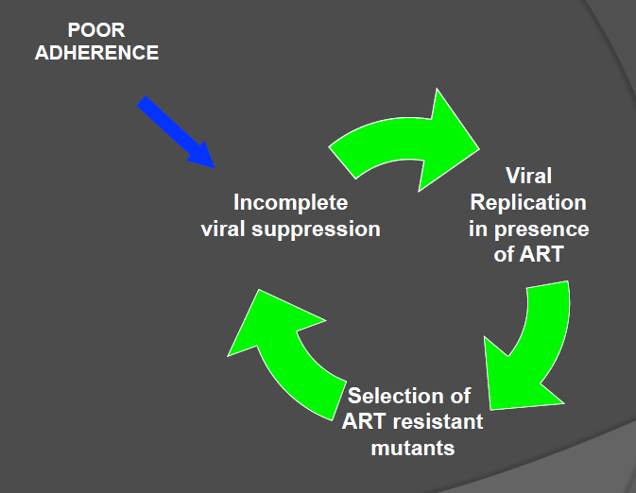
Resistance Can Be….
Due to inadequate drug levels due to:
  Long standing poor adherence (common)
  Drug interactions
  GI intolerance
Transmitted

Slide 26
Second Line Regimen
Discuss the following questions:
When would you switch to 2nd line?
  Demonstrated treatment failure per algorithm
Who is authorized to order?
  Trained clinician
Which drugs?
  Refer to WHO guidelines for appropriate regimen
Handout
2-5

Slide 27
Identifying programmatic strategy to enhance uptake of viral load

Slide 28
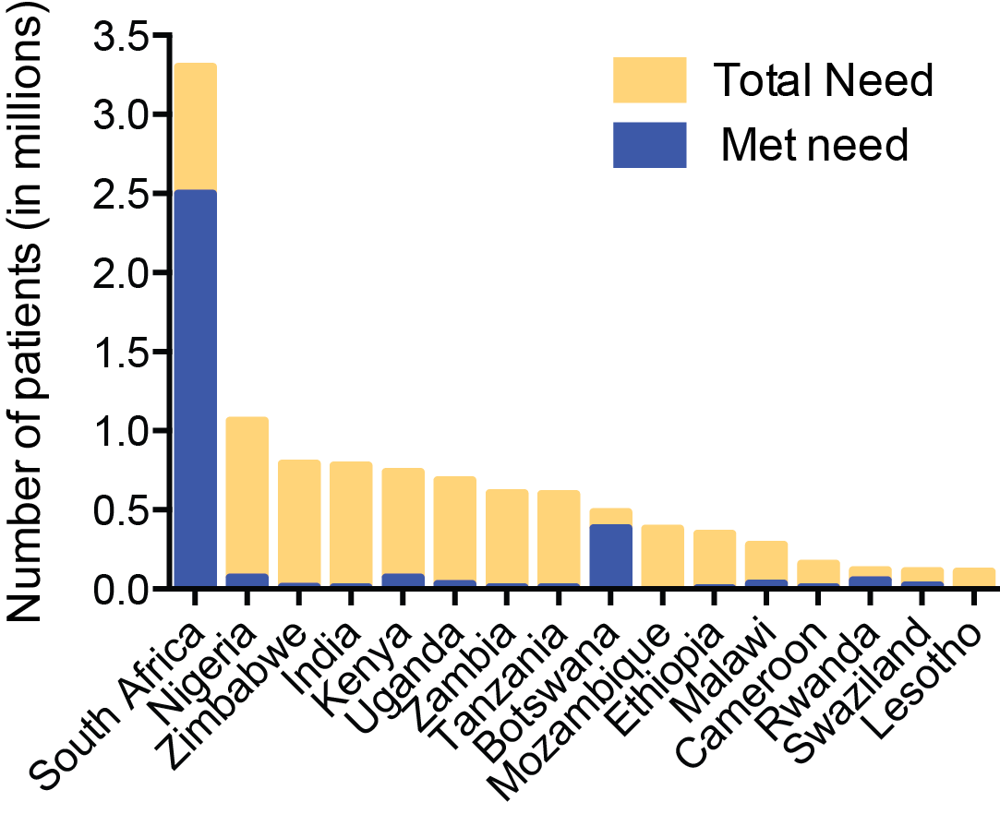
Programmatic Strategies to
Enhance Uptake of Routine Viral Load
Despite viral load being routine in guidelines, uptake is often low in resource-limited settings
Countries should adopt programmatic strategies that enhance uptake of routine viral load

Slide 29
Enhancing Uptake of Viral Load Monitoring
How will you ensure clients have a viral load taken according to the algorithm?
Example Strategies include:
  Patient education on when and why viral load should be taken
  Clear documentation or triggers in patient’s file/notebook that Viral Load is due at next appointment in order to allow triage of patients needing Viral Load in the waiting area
  Develop standard operating procedures (SOP) to ensure each patient’s viral load is taken according to the national algorithm
  Use High Viral Load form to document follow-up with repeat viral load testing
  Clinic staff follow-up with patients who missed a viral load using an enhanced adherence register

Slide 30
Enhancing Uptake of Viral Load Monitoring
Discuss: What is missing in this example patient form?
Date | Patient Name | Weight | Sex | TB status | New OI, Other Problems | Current ARV Drugs | CD4 Count | WHO Clinical Stage | ??????
Answer: Viral Load (# copies/ml)
Can also include: due date of next viral load test

Slide 31

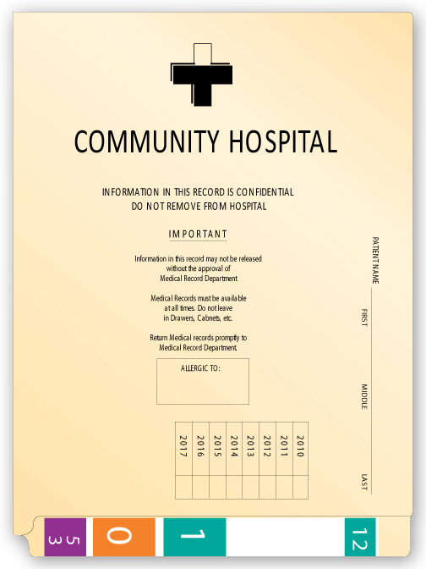


Enhancing Uptake of Viral Load Monitoring
Clear triggers help clinicians remember to take a viral load according to the algorithm
Take VL today please
Please take VL on:
1 Jan 2017

Slide 32
Example of a Standard Operating Procedure (SOP)
Patient arrives for appointment
Pull up chart and check for viral load test trigger
If the patient is due for a viral load test
If the patient is not due for a viral load test
Send the patient to the lab
Check the date of the next viral load test
Document that repeat test has been done
Remind patient of test and send to waiting area

Slide 33
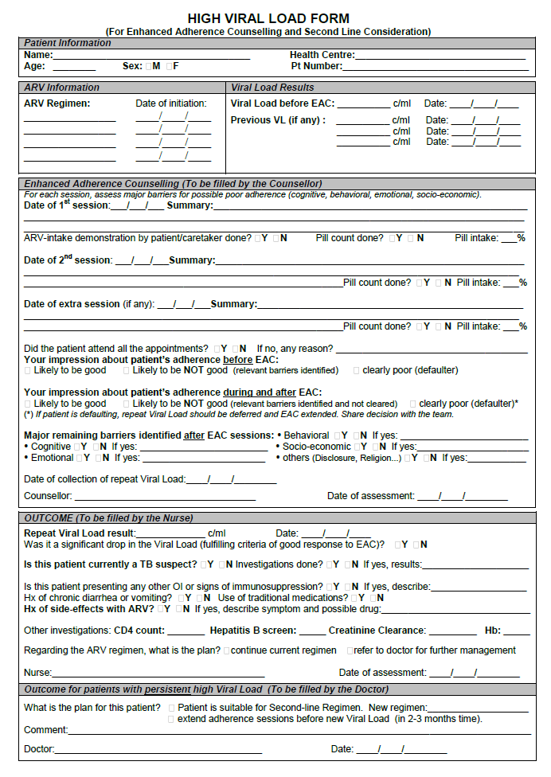
Use a High Viral Load Form for each patient requiring a repeat viral load
Viral load results before adherence counseling
Repeat viral load results and ARV regimen plan
Handout
2-6

Slide 34
Use an Enhanced Adherence Register to capture and monitor all patients with repeat viral load
Patients due for Repeat Viral Load Testing This Week: Jan 17 - 23
Patient Name Medical Record # | Previous Viral Load: Date and Result | Repeat Viral Load: Date completed | Repeat Viral Load: Date Received and Results
Patient A 123456 | 20 October 2015 10,000 copies/ml | 18 January 2016 | 25 January 2016 900 copies/ml
Patient B 987456 | 22 October 2015 10,000 copies/ml | ______________ | _______________ _______copies/ml
Handout
2-7

Slide 35
Activity 2B: Algorithm Case Studies
Purpose
To interpret Viral Load test results and determine appropriate next steps using the national Viral Load algorithm given a scenario
What will you need?
Activity 2B Case study sheet
What will you do?
Divide into 3 groups into one of the three case studies: A, B, or C.
  Review your assigned case and formulate group responses to the questions.
  Select a spokesperson for your group to present your group’s responses during the 2 minute class report.
  Participate in large-group discussion.
Handout
2-8
20 minutes

Slide 36
Case A: Discussion Points
Medical and enhanced adherence assessment required
Enter patient in high viral load register and complete high viral load form with clinical and adherence information
Viral load 2 repeated after 3-6 months if good adherence
Repeat viral load < 1000 copies/ml – continue on first line regimen

Slide 37
Case B: Discussion Points
Viral load may remain >1000 copies/ml even after improved adherence if drug resistance has developed
CD4 counts may increase even in the presence of treatment failure
Maintaining a failing regimen is associated with increased risk of resistance
When adherence improves and Viral Load remains >1000 copies/ml, patient should be switched to second-line regimens

Slide 38
Case C: Discussion Points
A low but detectable viral load could reflect some minor adherence issues
When the Viral Load measures <1000 copies/ml the likelihood of treatment failure is very low and patients should be continued on the same regimen with ongoing Viral Load monitoring

Slide 39
Module 2: Key Messages
Viral load is not just a monitoring tool to switch patients correctly to ____ line – it also helps people stay on ____ line
Clinicians must have clear ______ to remind them to take routine viral load according to their local algorithm
Any viral load > ______ copies/ml needs action!
Patients with a first viral load > 1000 copies/ml should start ____________________ and be assessed by a clinician
The repeat viral load should be taken _____ months after the first adherence counselling session (day first viral load > 1000 result given) if there has been good adherence since then
If viral load is _______copies/ml (initial or repeat) then maintain patient on the current ARV regimen

Slide 40
Module 2: Key Messages
Viral load is not just a monitoring tool to switch patients correctly to 2nd line – it also helps people stay on 1st line
Clinicians must have clear triggers to remind them to take routine viral load according to their local algorithm
Any viral load > 1000 copies/ml needs action!
Patients with a first viral load > 1000 copies/ml should start adherence counselling and be assessed by a clinician
The repeat viral load should be taken 3-6 months after the first adherence counselling session (day first viral load > 1000 result given) if there has been good adherence since then
If viral load is < 1000 copies/ml (initial or repeat) then maintain patient on the current ARV regimen

